Slide 1


Advances in Streaming Novelty Detection
By Ander Carreño – Ph. D. Candidate
Supervised by: Iñaki Inza and Jose A. Lozano
Notes:
Good morning and welcome to my PhD candidate thesis defense. I am Ander Carreño who has been a PhD student since 2018 under the supervision of Iñaki Inza and Jose A. Lozano. Firstly, I would like to thank the jury, my supervisors and the public for coming. This dissertation is titled: Advances in Streaming Novelty Detection and proposes some methodological frameworks that solve the Streaming Novelty Detection problem, which is a problem where new classes can emerge in an online or streaming environment without supervision.

Slide 2
Motivation and Scope
Solving a novelty detection problem in stream
What is in the literature?
Mix-up between terms and problems
?
Problem A
Term 1
Problem A
Term 2
Problem B
Problem B
Term
Term 3
Problem C
Problem C
Problem D
Term 4
Problem D
Notes:
We
We started dealing with a novelty detection problem and when we looked into the literature for new insights we discovered that what we refer to as novelty was different in a variety of works. Then we realized that there was a term that was indistinctly being used to refer to a set of different problems and, similarly, a problem was associated with different terms

Slide 3
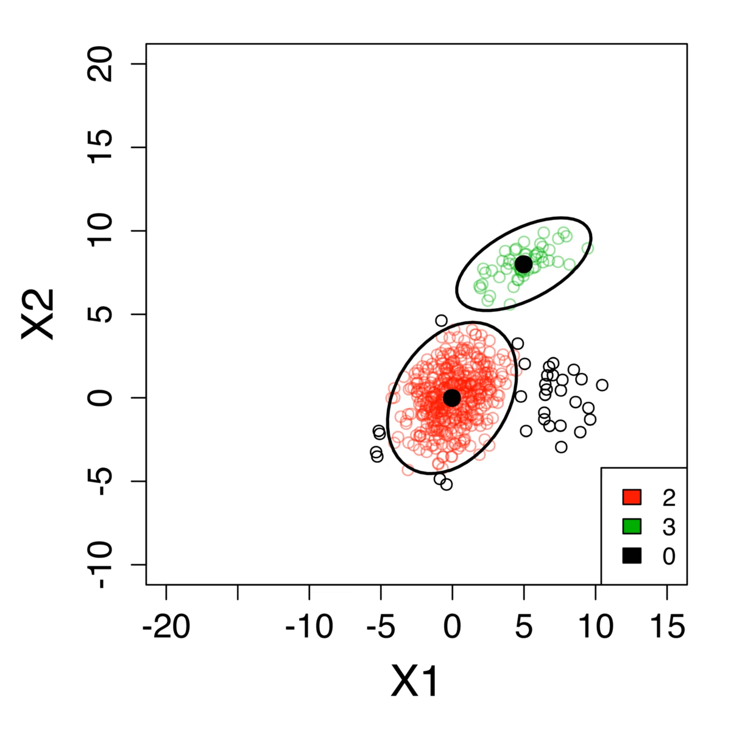
Motivation and Scope
Taxonomy of terms and problems
Ad-hoc literature approaches
Propose a robust probabilistic framework for Streaming Novelty Detection (SND) problems
Notes:
We
We started dealing with a novelty detection problem and when we looked into the literature for new insights we discovered that what we refer to as novelty was different in a variety of works. Then we realized that there was a term that was indistinctly being used to refer to a set of different problems and, similarly, a problem was associated with different terms

Slide 4
Motivation and Scope
Taxonomy of terms and problems
Propose a robust probabilistic framework for Streaming Novelty Detection (SND) problems
What if instances are Time Series?
Probabilistic modelling for time series?
Opted to choose deep learning solutions
Notes:
We
We started dealing with a novelty detection problem and when we looked into the literature for new insights we discovered that what we refer to as novelty was different in a variety of works. Then we realized that there was a term that was indistinctly being used to refer to a set of different problems and, similarly, a problem was associated with different terms

Slide 5
Motivation and Scope
Solving a novelty detection problem in stream
What is in the literature?
Mix-up between terms and problems
Taxonomy of terms and problems
Ad-hoc literature approaches
Propose a robust probabilistic framework for Streaming Novelty Detection (SND) problems
If instances are time series?
Looked into the literature and finally opted for deep learning solutions
Notes:
We
We started dealing with a novelty detection problem and when we looked into the literature for new insights we discovered that what we refer to as novelty was different in a variety of works. Then we realized that there was a term that was indistinctly being used to refer to a set of different problems and, similarly, a problem was associated with different terms

Slide 6
Motivation and Scope
Mix-up between terms and problems
?
Problem A
Term 1
Problem A
Term 2
Problem B
Problem B
Term
Term 3
Problem C
Problem C
Problem D
Term 4
Problem D
Notes:
We
We started dealing with a novelty detection problem and when we looked into the literature for new insights we discovered that what we refer to as novelty was different in a variety of works. Then we realized that there was a term that was indistinctly being used to refer to a set of different problems and, similarly, a problem was associated with different terms

Slide 7
Index
Propose a one-to-one assignment of terms to learning scenarios
Propose a Streaming Novelty Detection (SND) solution based on probabilistic distributions
Propose a SND solution that deals with time series data

Slide 8
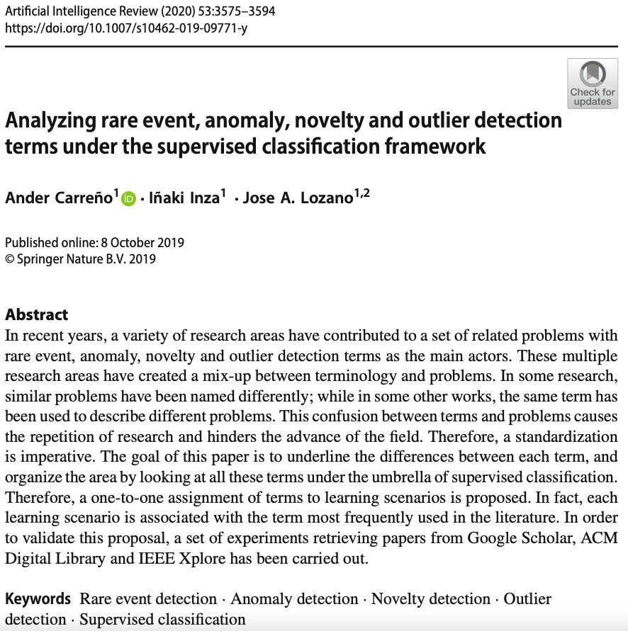
Analyzing rare event, anomaly, novelty and outlier detection terms under the supervised classification framework

Slide 9
Terms analyzed
Rare events, anomalies, novelties, outliers, aberrations, abnormalities, issues, noise, surprises, contaminants, peculiarities…
Problems associated to these terms:
(Highly) Unbalanced supervised classification
(Early) Time series supervised classification
Supervised Classification with only one class for learning
Unsupervised classification

Slide 10
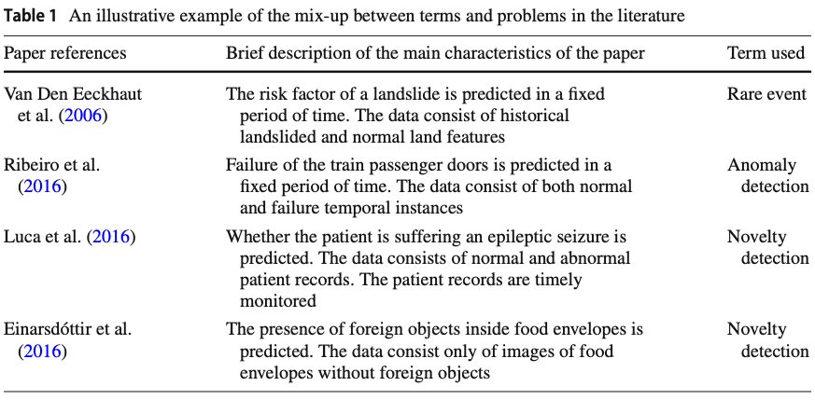
Review of the literature
Exposure of the problem
Notes:
Visto esto nosotros proponemos lo siguiente...

Slide 11
Foundation of the taxonomy
Key papers from the literature
Other papers try to clearly define their learning scenario before continuing with their research in the introduction section
They realize that there is a confusion of terms
Based on these key papers we propose our taxonomy
Validated through an extensive evaluation
Notes:
Visto esto nosotros proponemos lo siguiente...

Slide 12
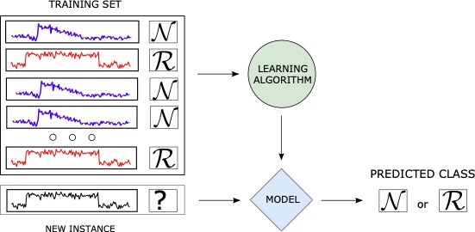
Problem specification
Rare Event Detection
Supervised Classification
The instances are time series
denotes the time-step data value
Goal: Recognize rare events

Slide 13
Problem specification
Anomaly Detection
Supervised Classification
The instances are vectors without temporal correlation
Goal: Detect the anomalies

Slide 14
Problem specification
Novelty Detection
The instances are vectors without temporal correlation
Supervised Classification
Goal: detect novelties

Slide 15
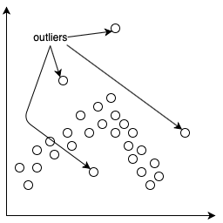
Problem specification
Outlier Detection
Unsupervised Classification
The instances are vectors without temporal correlation
Goal: Clean data, remove outliers. Not the final goal of the classif. task

Slide 16
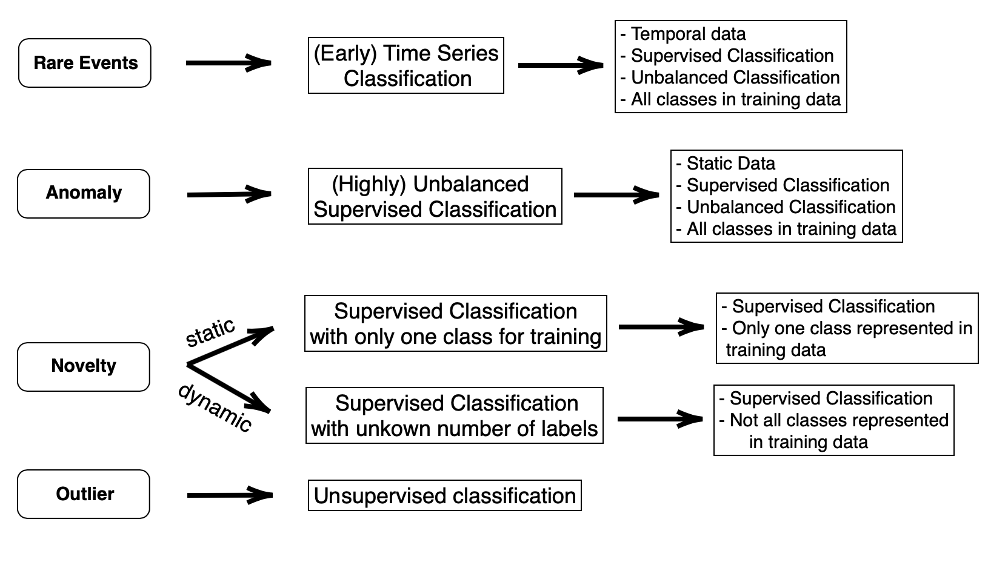
One-to-one assignment of terms to learning scenarios

Slide 17



Validation of the proposed assignment
Experiment setup
Scenario A
50 most cited papers after the year 2000 (2000 – 2020)
Scenario B
First appearing 50 search results after 2014 (2014 – 2020)

Slide 18
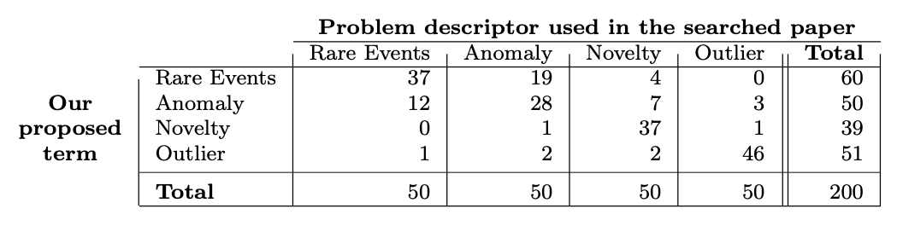
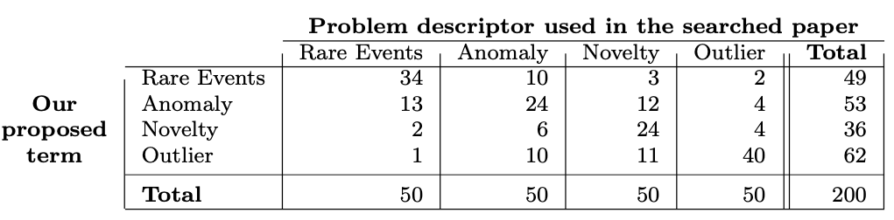
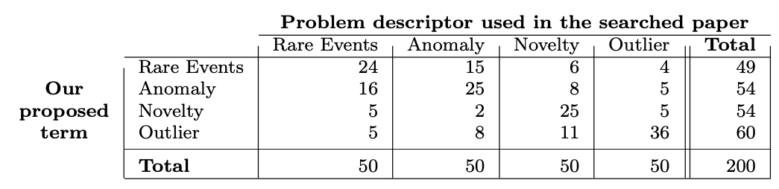
Validation of the proposed assignment
Scenario A: Most cited papers
Google Scholar
ACM Digital Library
IEEE Xplore

Slide 19
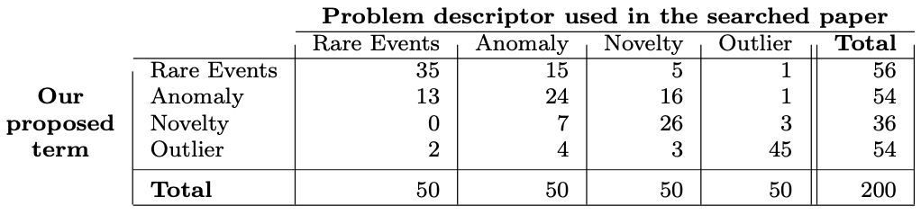
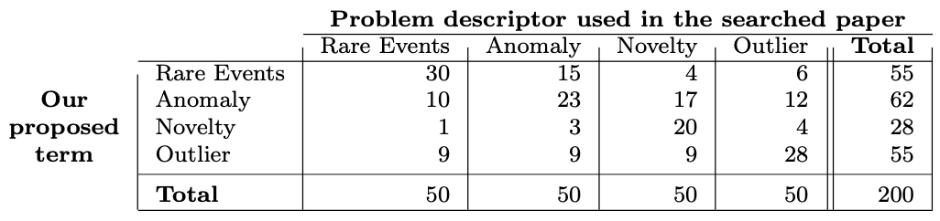
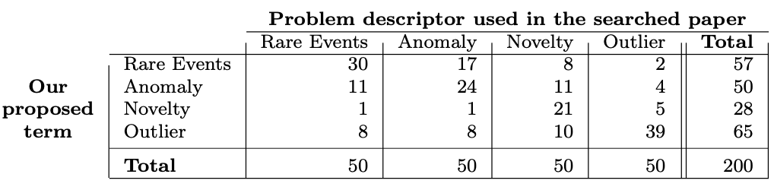
Validation of the proposed assignment
Scenario B: First appearing search-results
Google Scholar
ACM Digital Library
IEEE Xplore

Slide 20
Conclusions
Detect and expose the current mix-up between terms and problems
Propose a one-to-one assignment of terms to learning scenarios
Define the learning scenarios and their characteristics
Give short step into the standardization of the field
Clarify the path for (specially) newcomer researchers to the field

Slide 21

General explanation of the SND problem

Slide 22
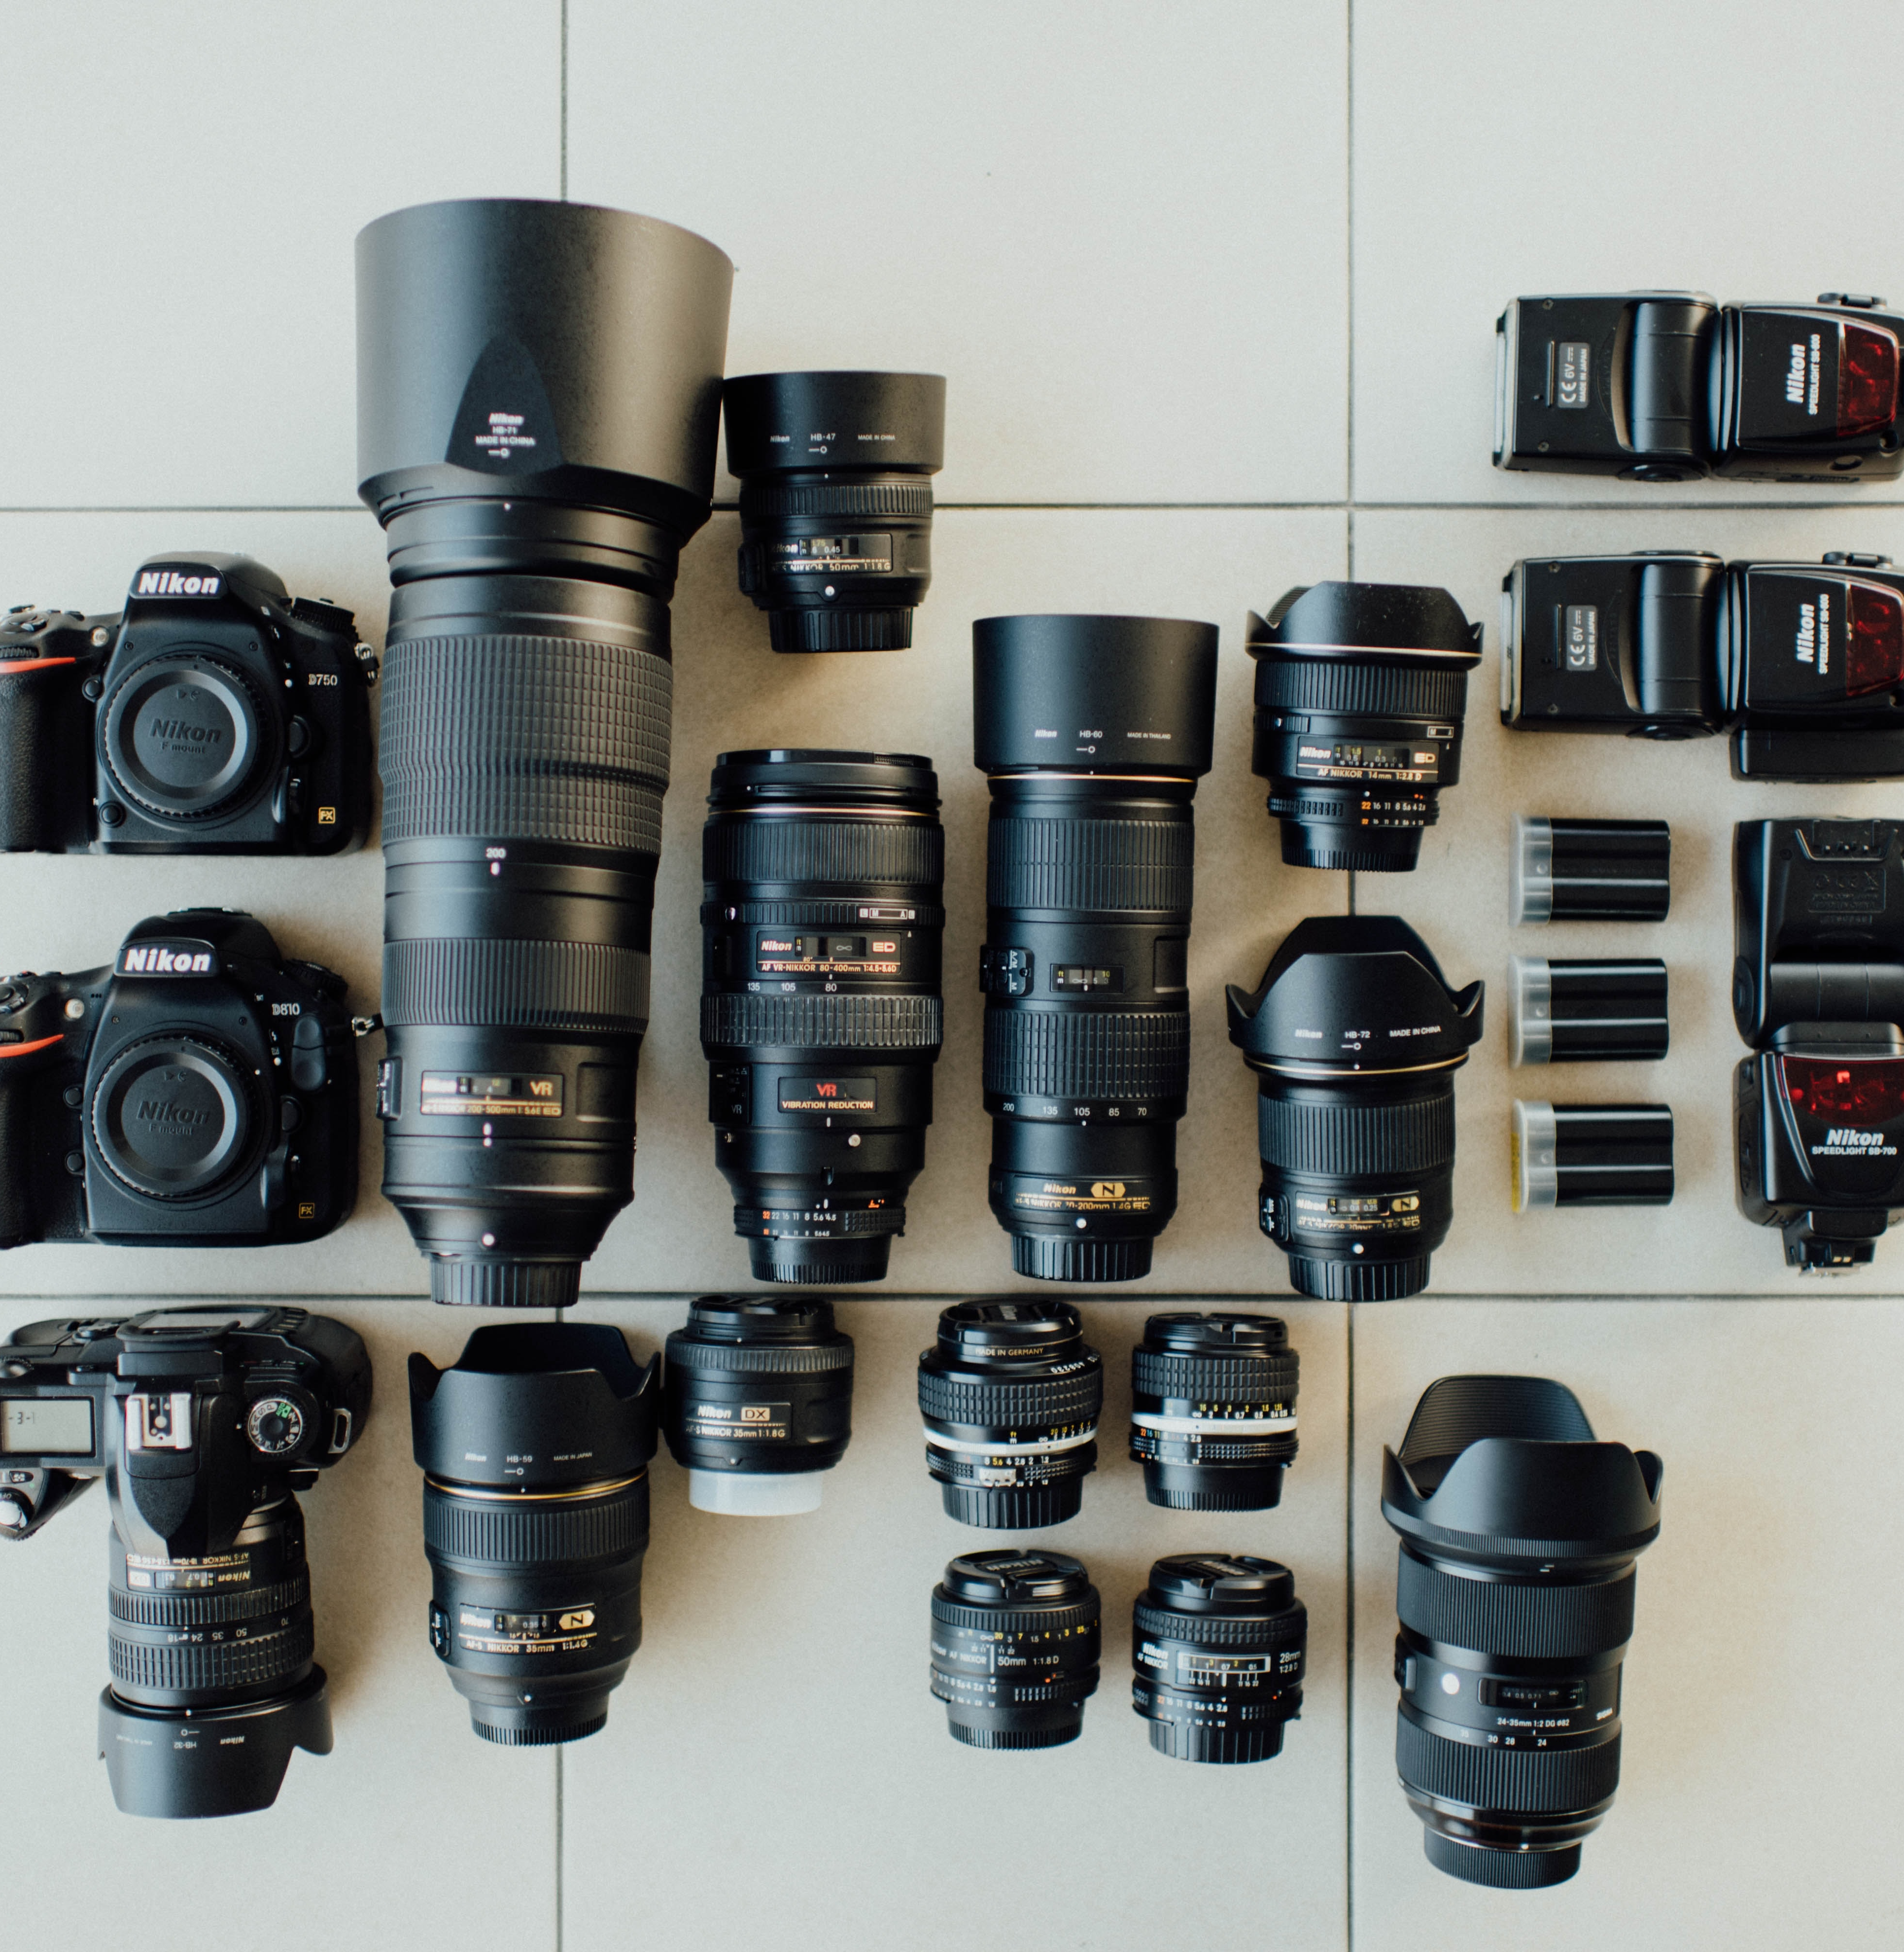
Objective in SND
Discover new classes automatically in a streaming environment
Accurately predict newcomer instances

Slide 23


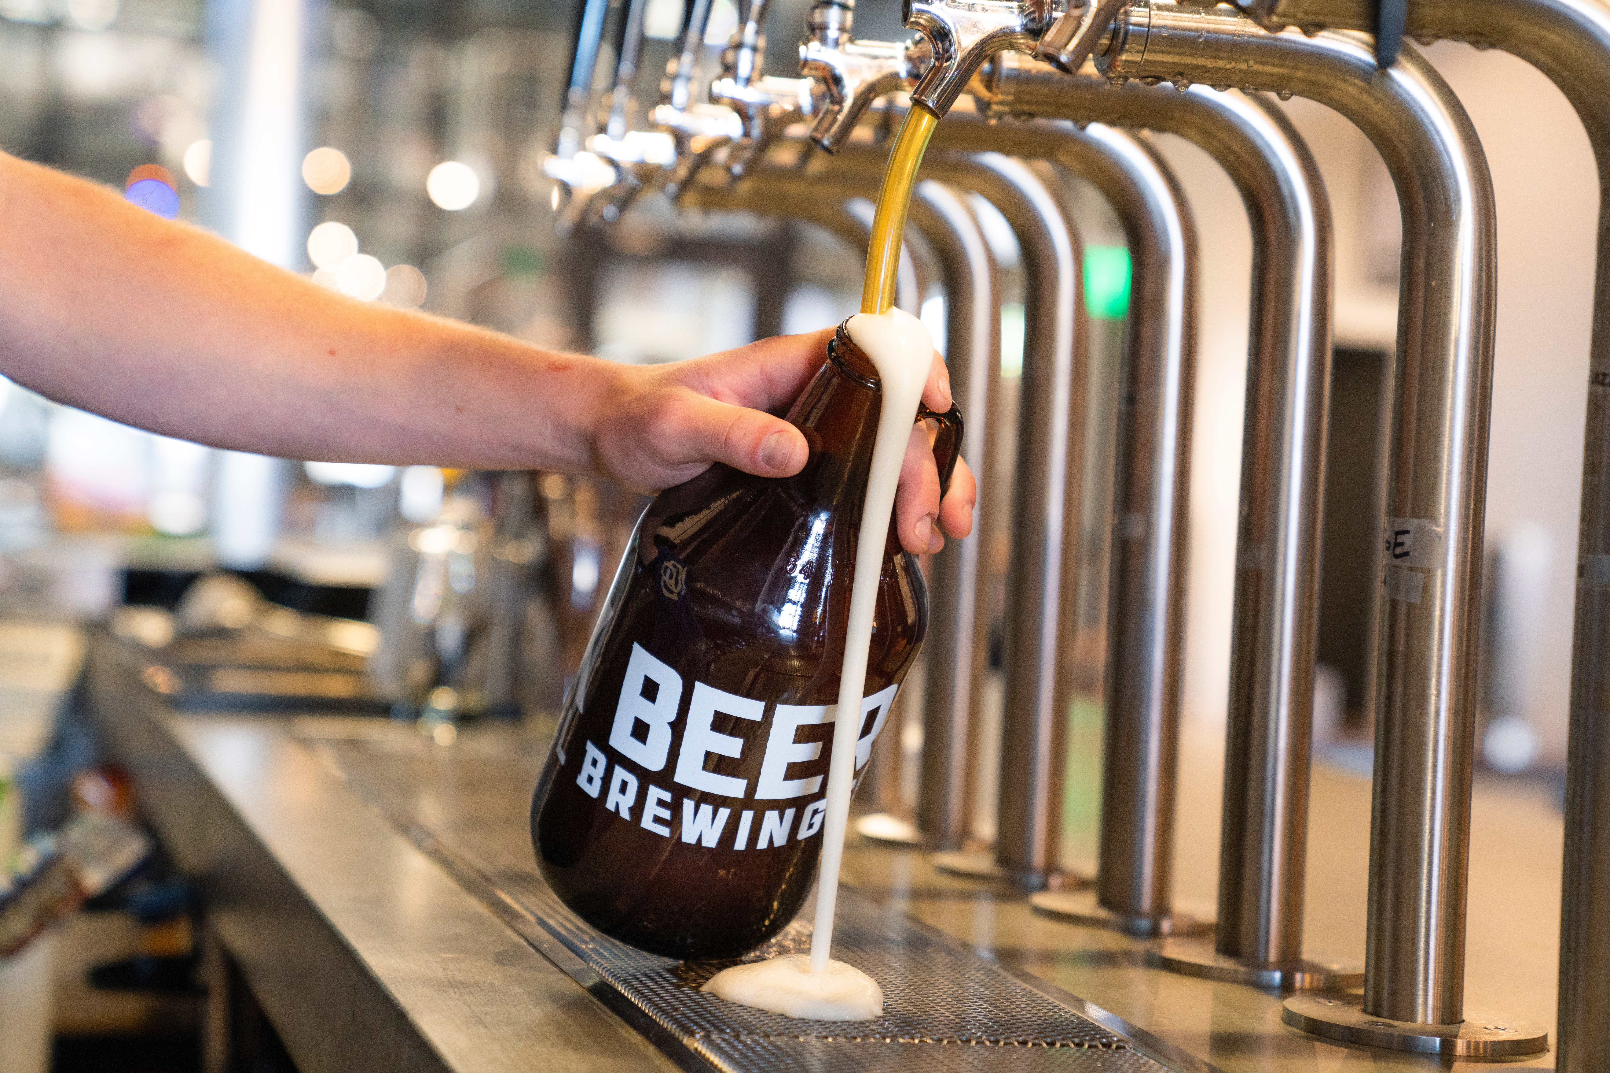
Streaming learning scenario
Unsupervised new class discovery
Concept Drift
Memory Limitations

Slide 24


General SND split approach
Learning Stage
Prediction Stage
Model Update Process
Offline Phase
Online Phase

Slide 25
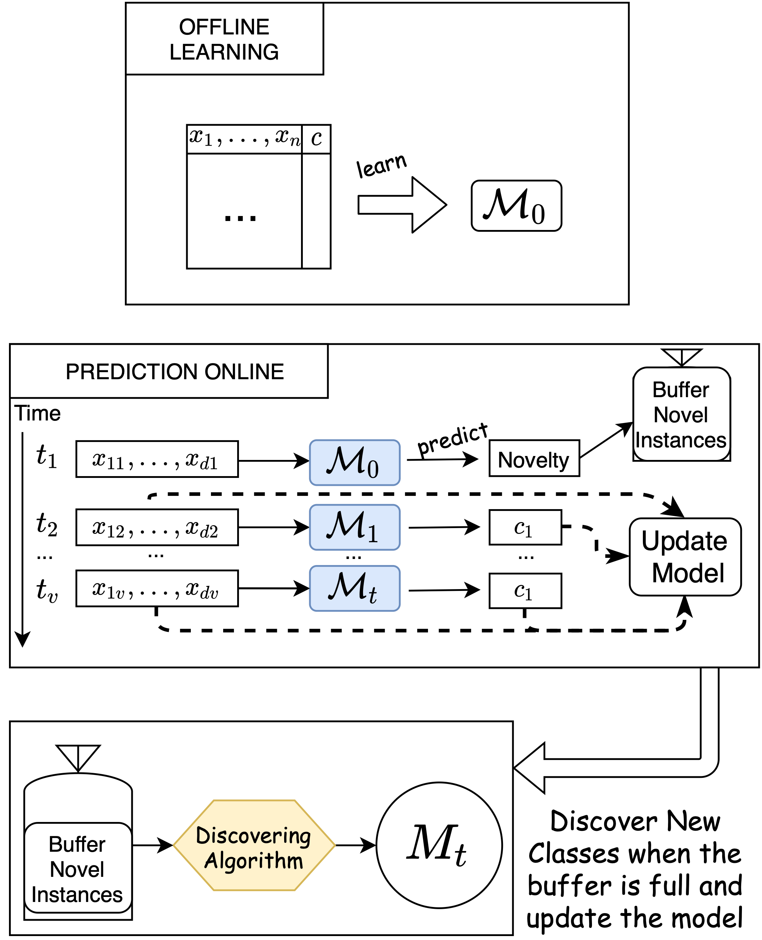
General Flowchart of SND
OFFLINE LEARNING
learn

Slide 26
General Flowchart of SND
OFFLINE PHASE
Time
learn
Predicts
. . .
. . .
. . .
ONLINE PHASE
Update process
Buffer Novel Instances

Slide 27
General Flowchart of SND
ONLINE PHASE
Updated model
UPDATE PROCESS
Buffer Novel Instances
Predictions of buffered instances

Slide 28
Literature Approaches for SND
Faria, E. R., et. al. (2016). MINAS: multiclass learning algorithm for novelty detection in data streams.
Data Mining and Knowledge Discovery, 30(3), 640–680.
Class 2
Based on joining multiple Clusters
K-Means
Prediction requires many Euclidean Distances
Class 1

Slide 29
Literature Approaches for SND
Zhu, Y., Ting, K. M., & Zhou, Z. H. (2018). Multi-label learning with emerging new labels. IEEE Transactions on Knowledge and Data Engineering, 30(10), 1901–1914.
Notes:
paralel splits

Slide 30
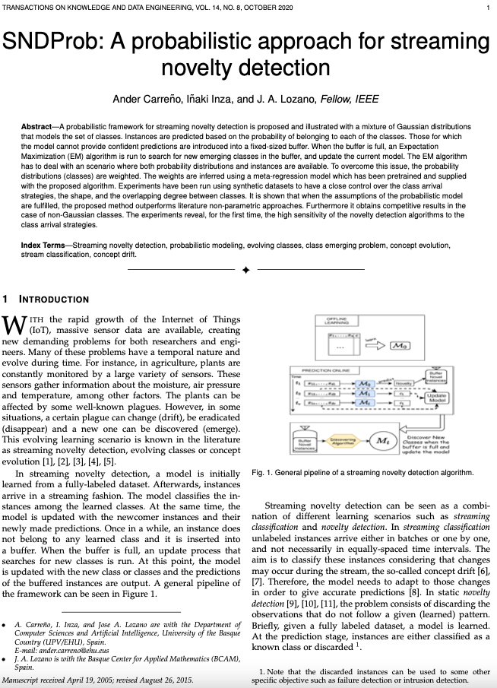
SNDProb: A probabilistic Approach for Streaming Novelty Detection

Slide 31
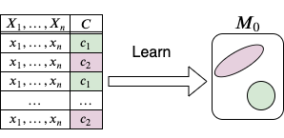
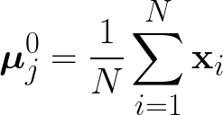
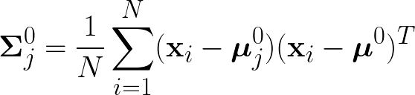
Learning from data
OFFLINE PHASE
For each class, learn a Gaussian distribution.

Slide 32

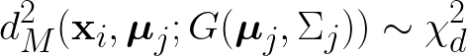
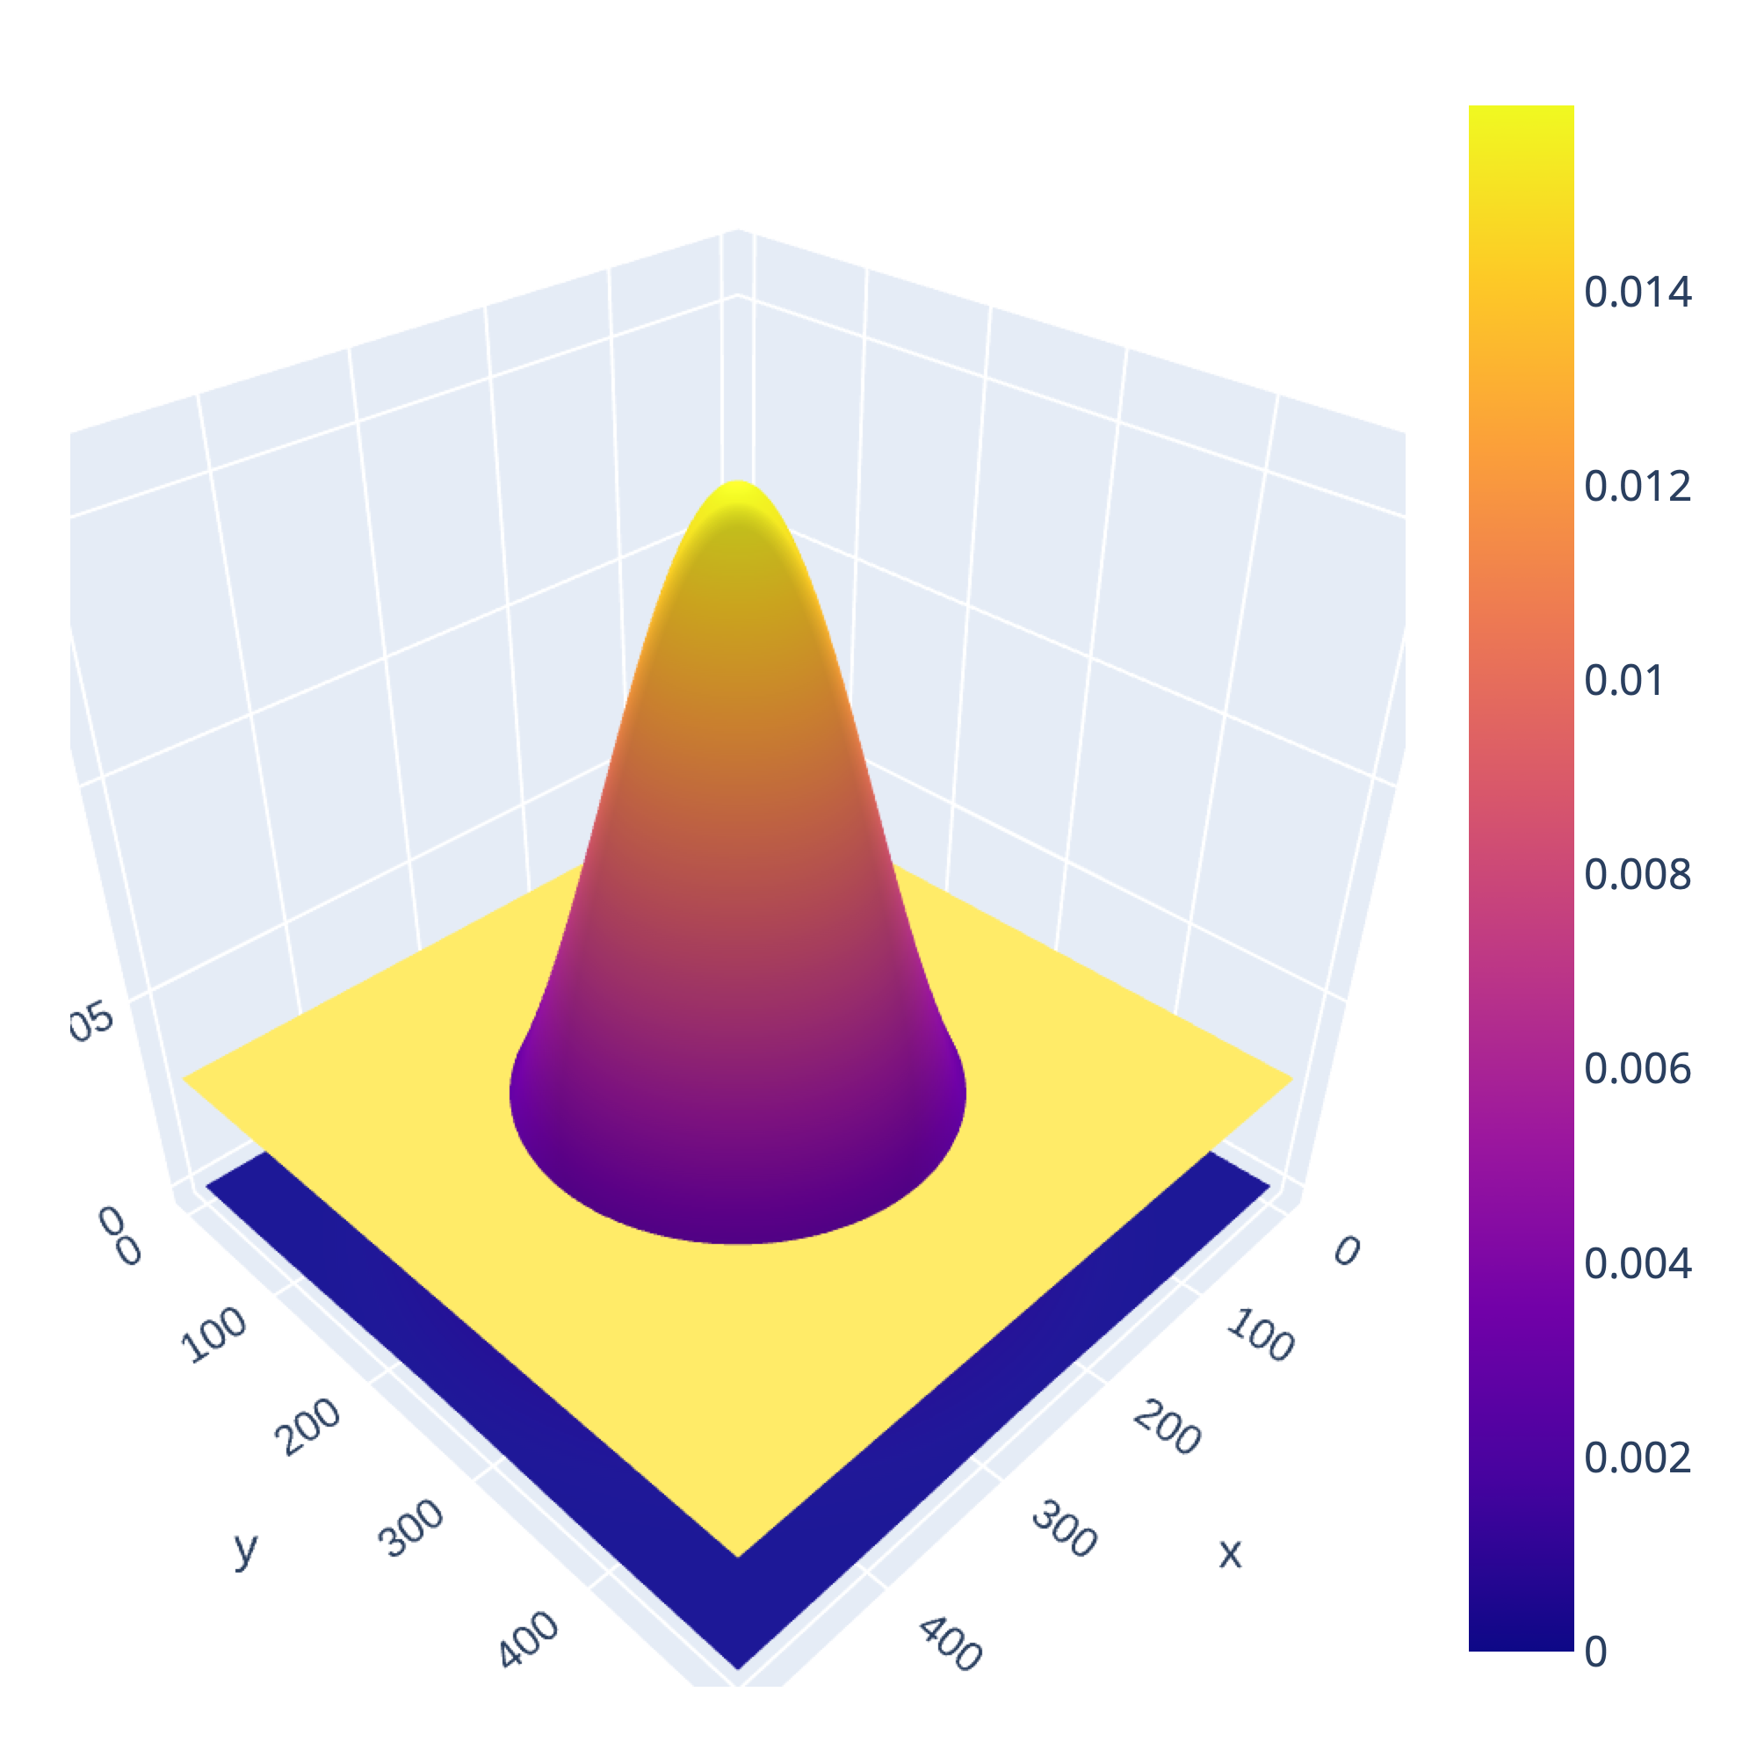
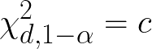
Prediction
ONLINE PHASE
How to classify a newcomer instance
Trick!
Mahalanobis Distance
The instance must be inside a fixed percentage of density mass
98%
98% of prob mass
Sent to buffer the
instances that fall in here
Notes:
Mejorar la imagen de la Gaussiana – Decir el buffer size!

Slide 33
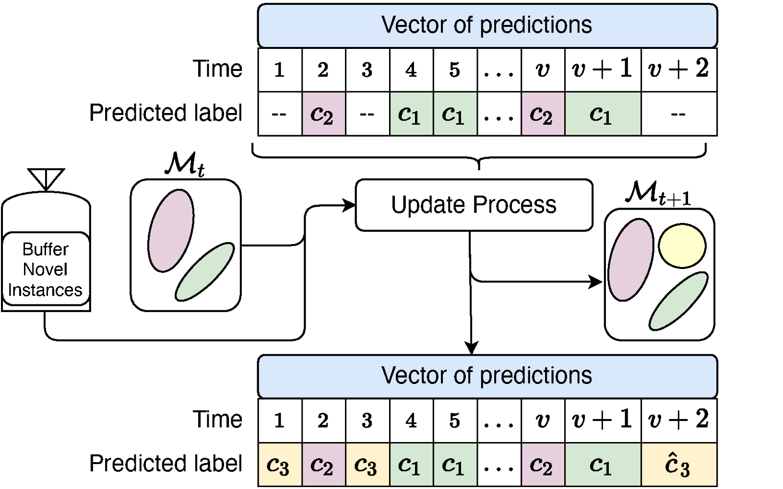
Summary before details
PREDICTION FLOWCHART
UPDATE PROCESS FLOWCHART

Slide 34
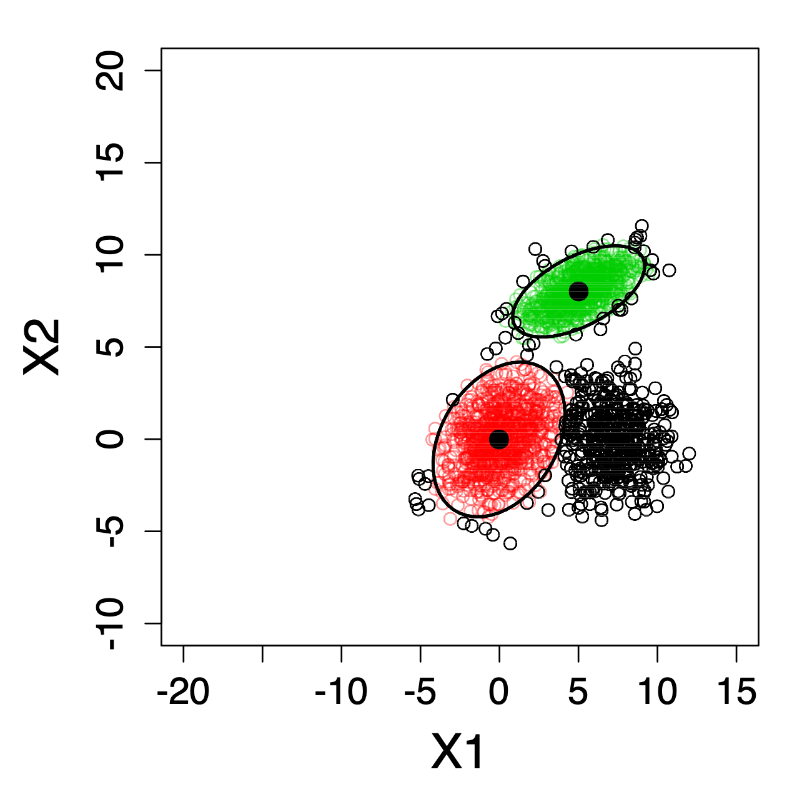
First – Possible situations when discovering

Slide 35

What do we have?
Probability distributions
that represent the OLD data
BALANCE
Buffered data
that represents NEW data

Slide 36
EM Algorithm
Tradeoff between old and new data
1
Buffer
EM Algorithm
N
w1
µ
,
∑
w2
µ
,
∑
Notes:
CAMBIAR COLOOOOR!!!!!!!!!!

Slide 37
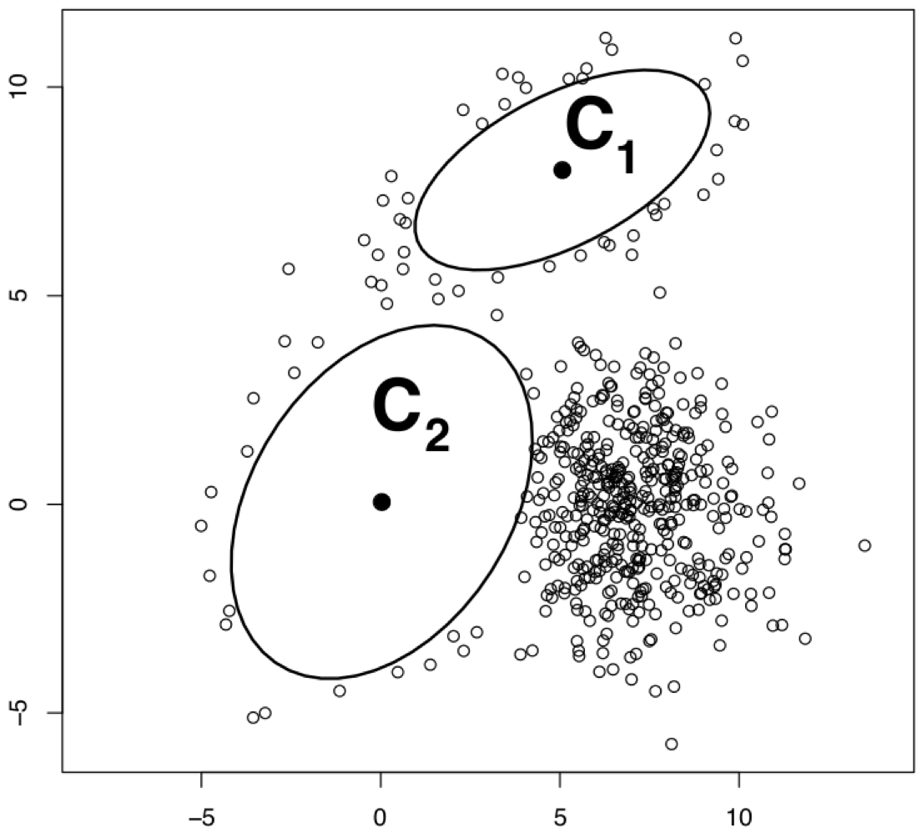
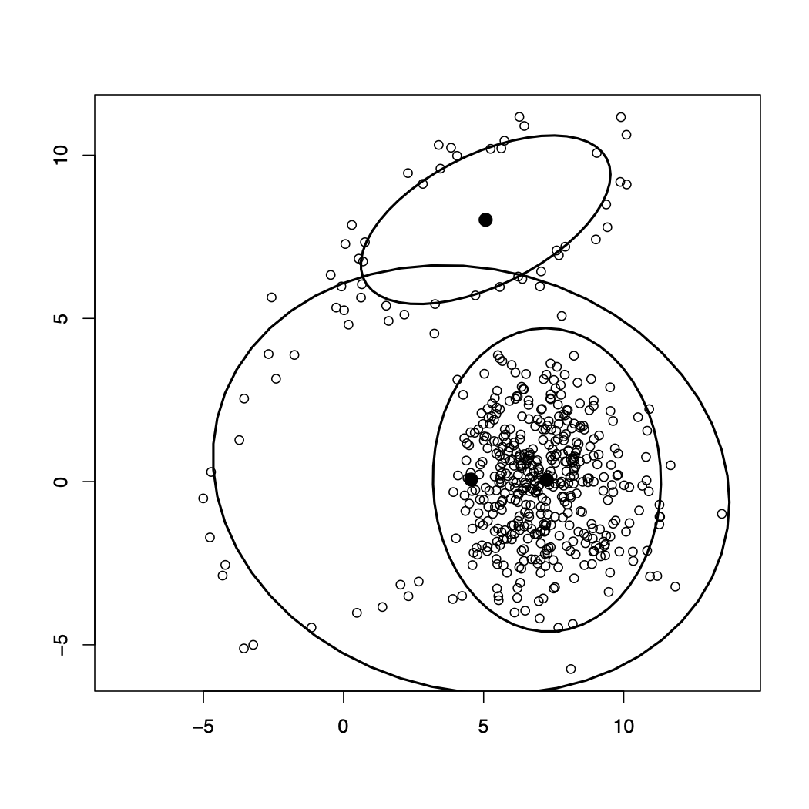
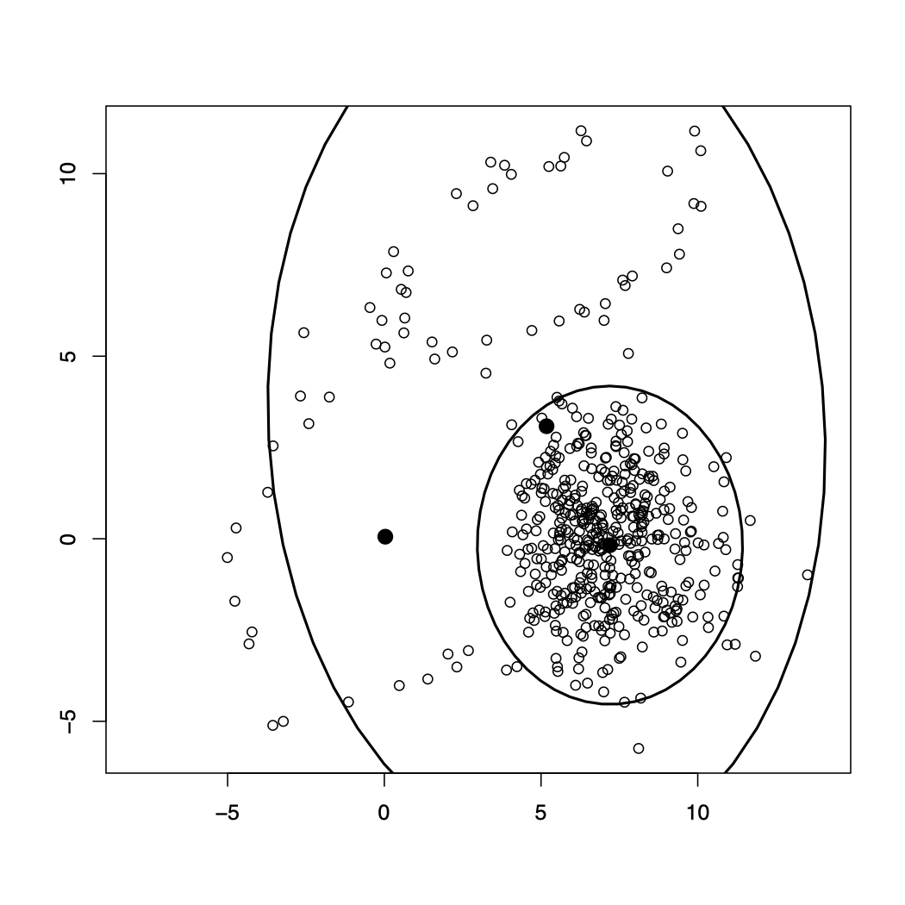
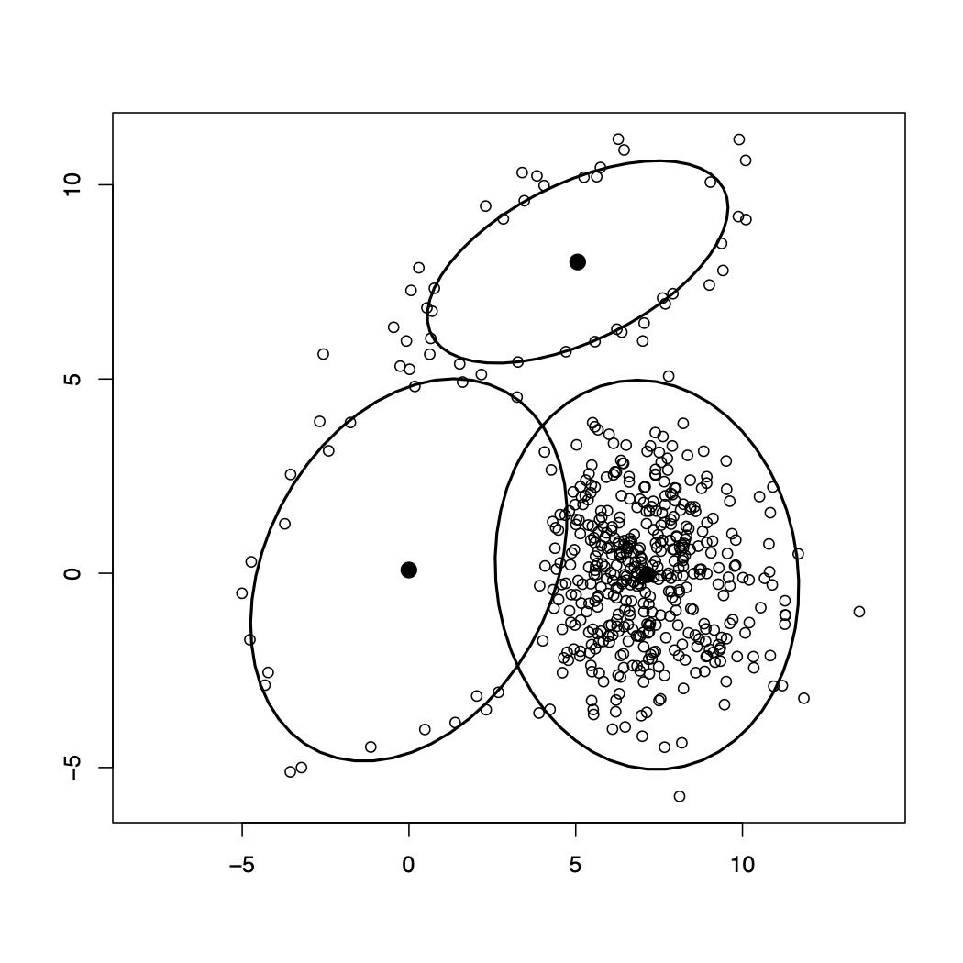
The buffer is fixed to 500 instances
w1 = 365
w2 = 812
w1 = 50
w2 = 800
w1 = 365
w2 = 812
How do we find the best set of weights?

Slide 38
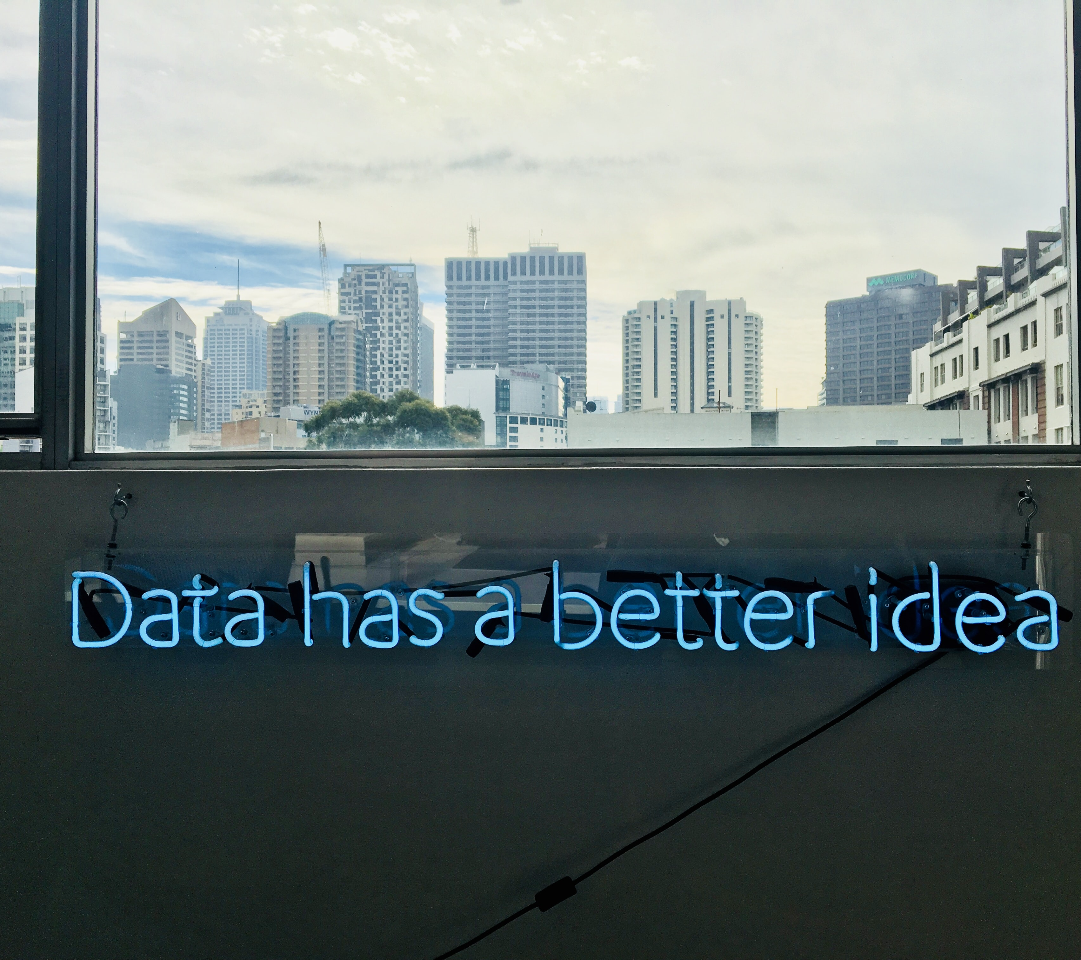
Discovering new classes
Learning a multi output regression model
Use a 2 stage
meta-regression approach
Novelty detection
1
Random Forest Classifier
Concept Drift
2
3NN model to infer the weights
As many regression models as number of classes to be predicted

Slide 39
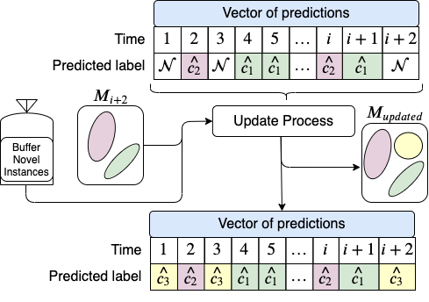
Discovering new classes
Offline Phase
Online Phase
Time
Buffer full
Buffer full
Meta-features of each epoch:
Number of instances classified of each class
Entropy of the mixture model (to model the overlapping)
Mean and variance of the inter arrival time of each class
Mean and variance of the density that the models assign to the instances of the buffer

Slide 40
Notes before the results
MINAS algorithm
When instances are introduced into the buffer, they are not counted as an Error or success!
SENCForest algorithm
It only can discover one class. It assigns the same class label to all new instances
SNDProb
We provide predicted labels when the buffer is released for the buffered instances
Notes:
PREPARAR BIEN EL DISCURSO
We encounter difficulties to unify the experimentation setup. Such as….

Slide 41

Experiments
Our personal view of how this should be tested
Consider how the classes arrive
Control how the classes are set in the feature space
Do they overlap?
Take into account how many new classes arrive at a time
Evaluation Measures?
Upper bound? Supervised SNDProb
Notes:
QUITAR EL BLOQUE AZUL

Slide 42
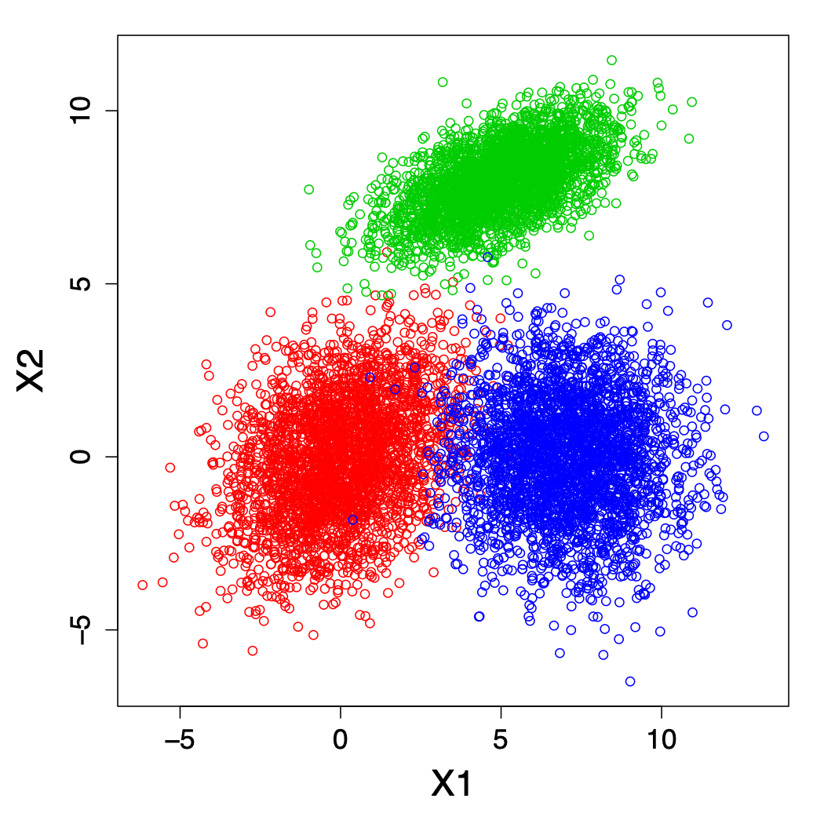
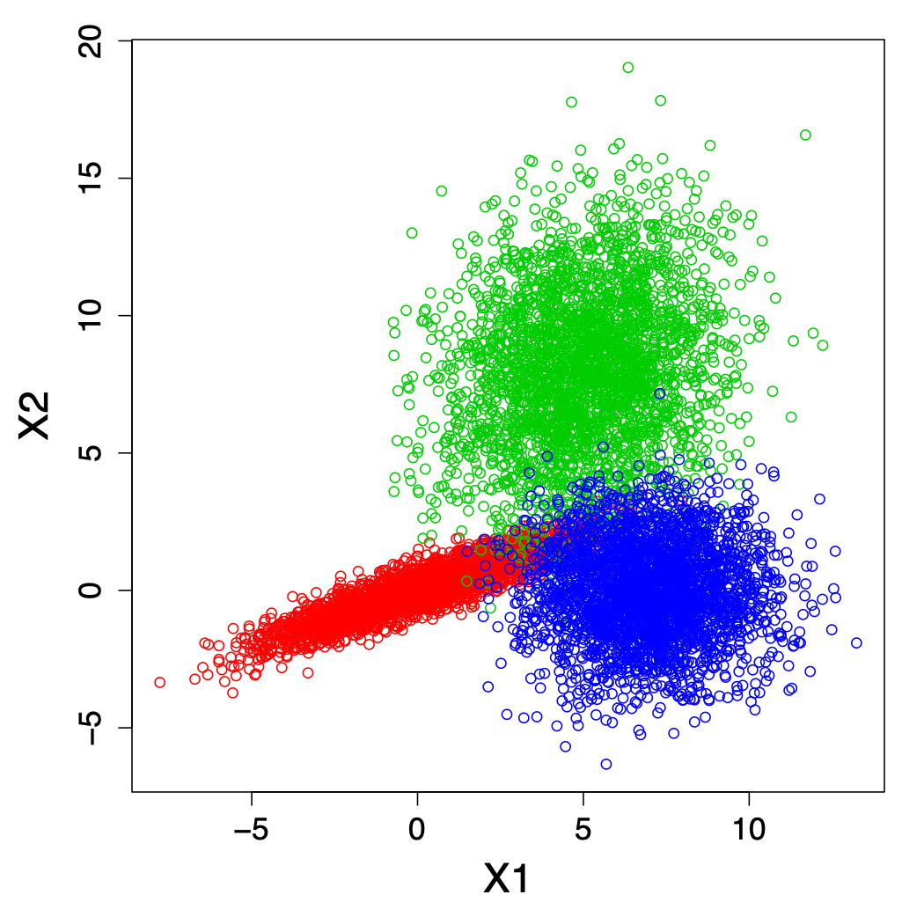
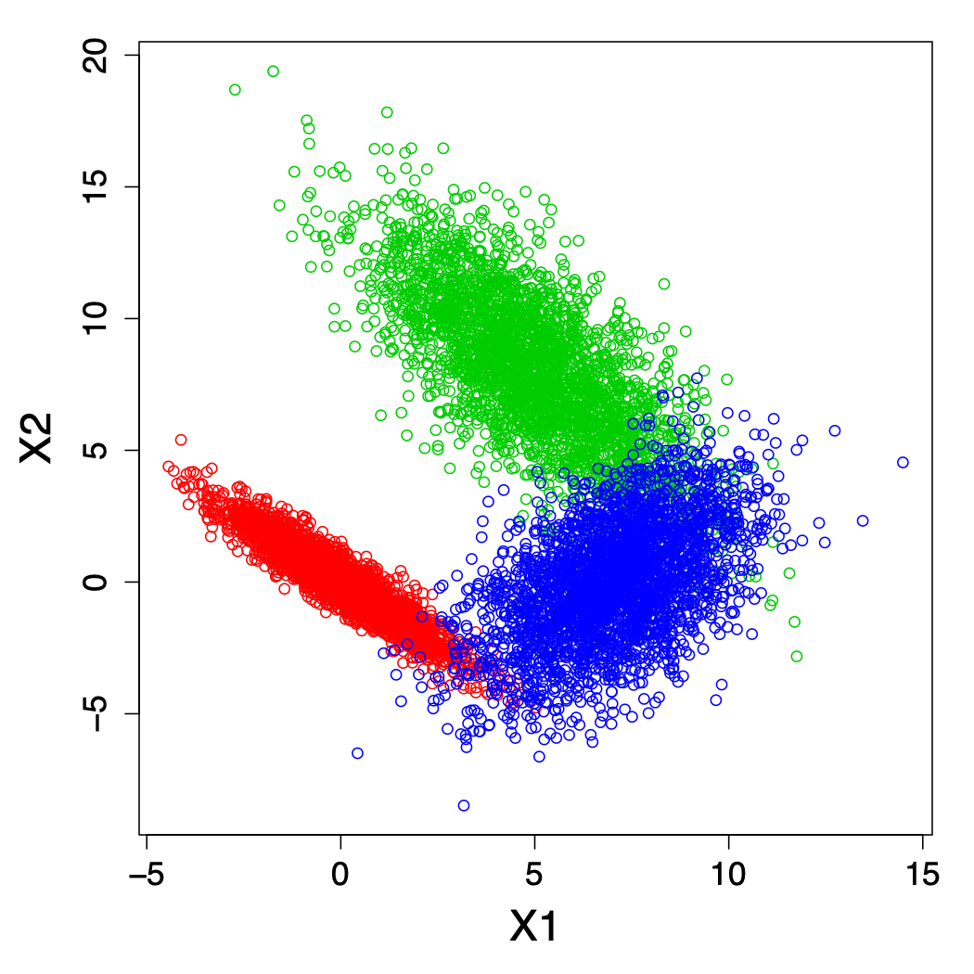
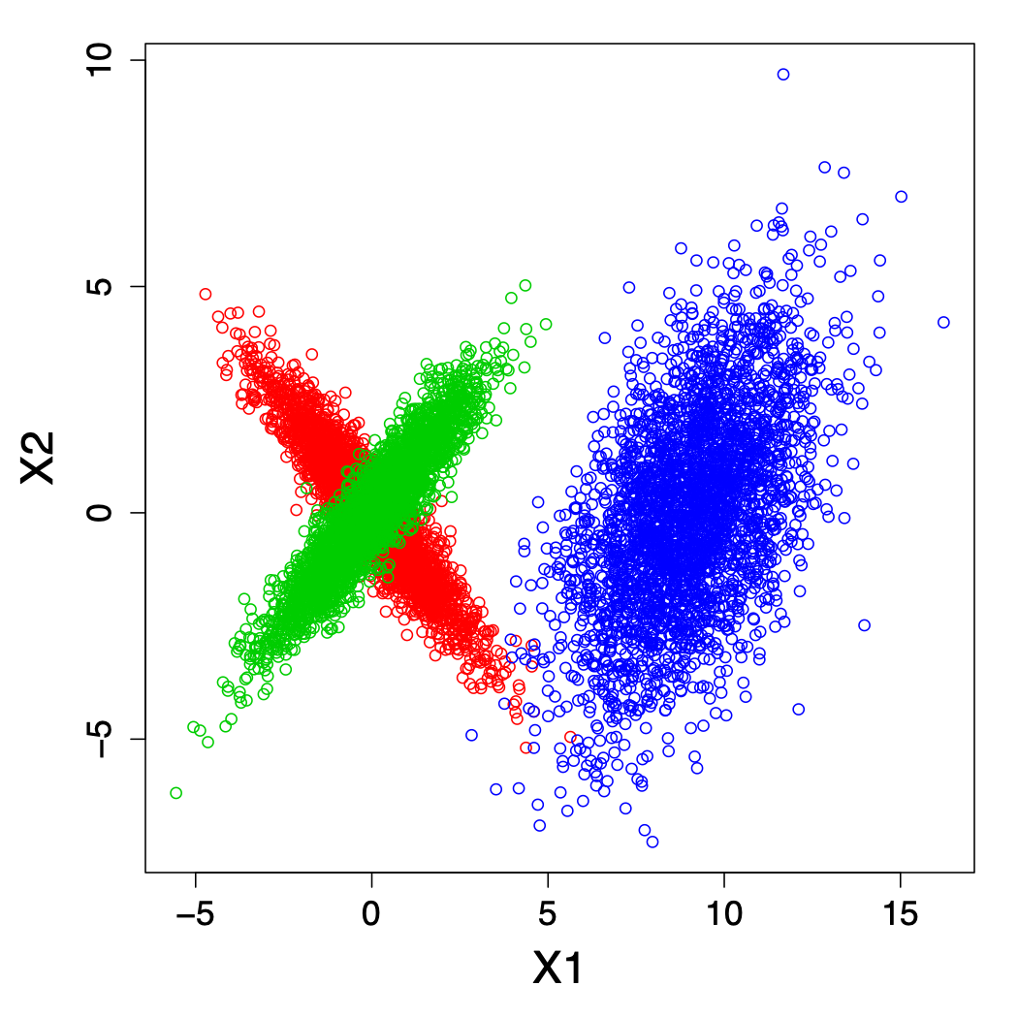
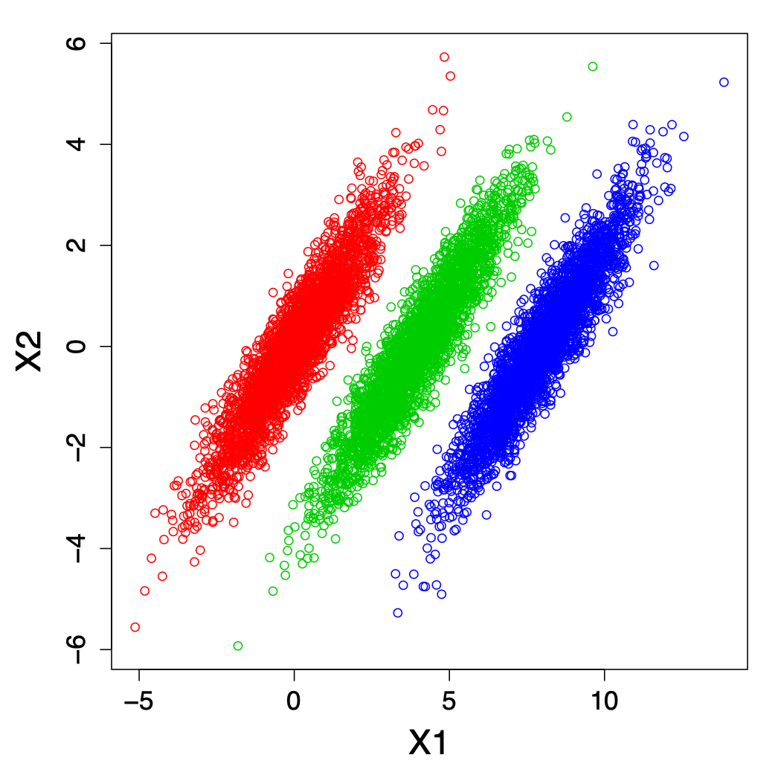
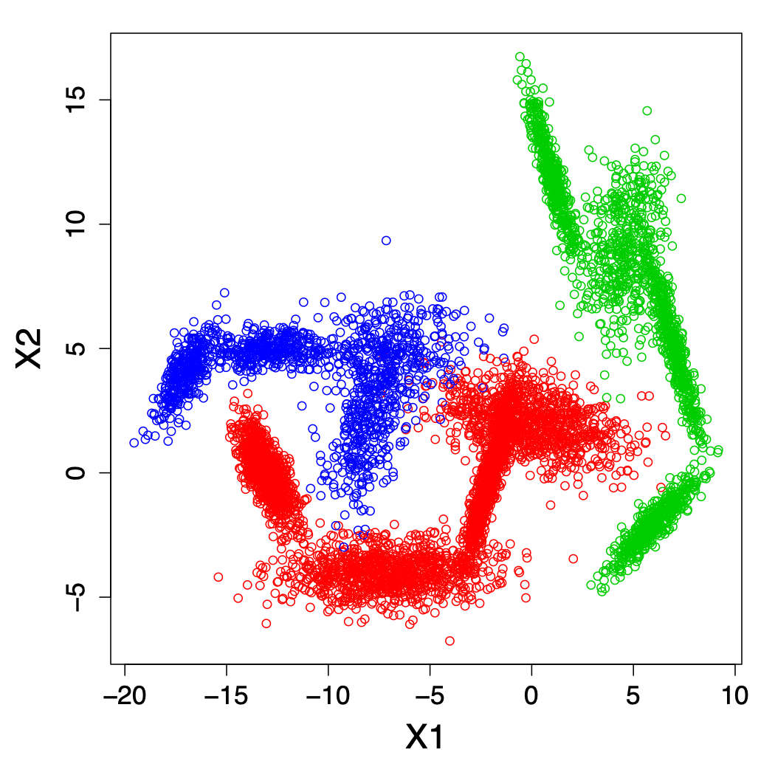
Synthetic Scenarios and Arrival Strategies
TRAIN
Notes:
5 gaussianos, 1 no

Slide 43
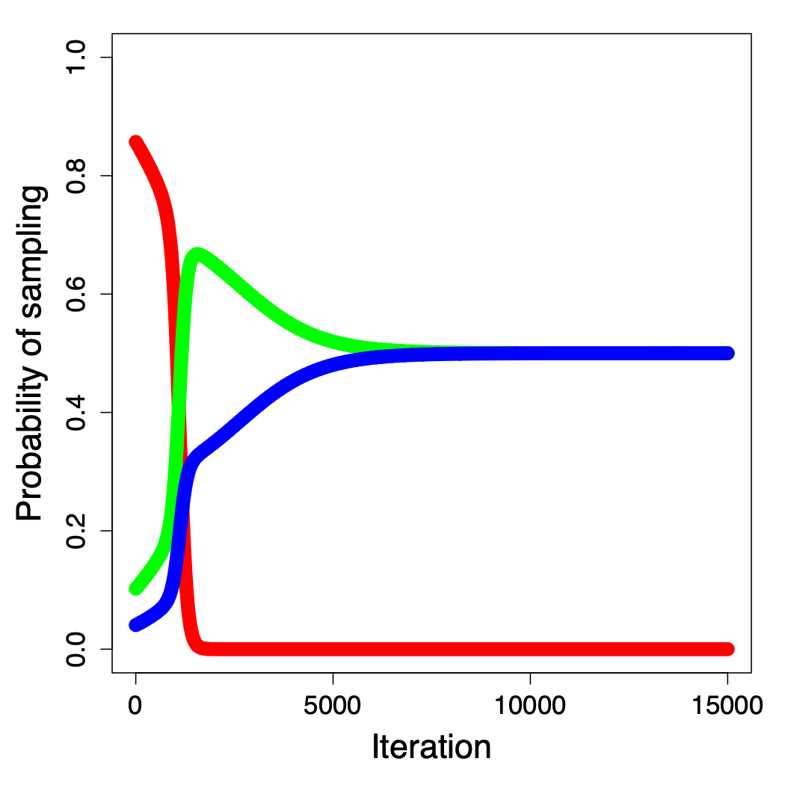
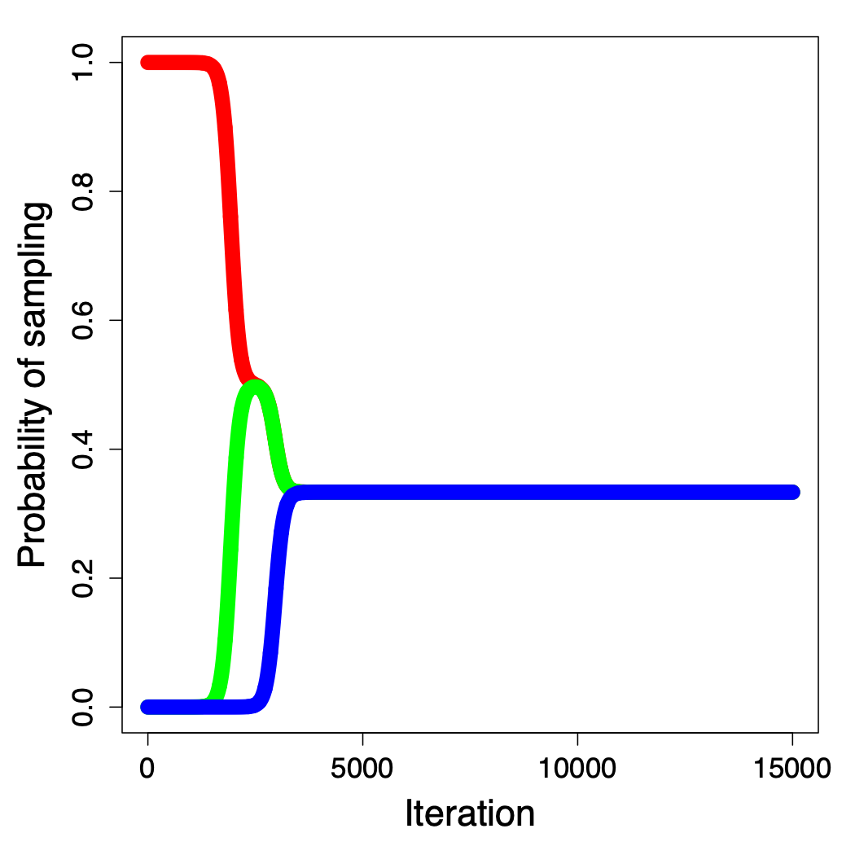
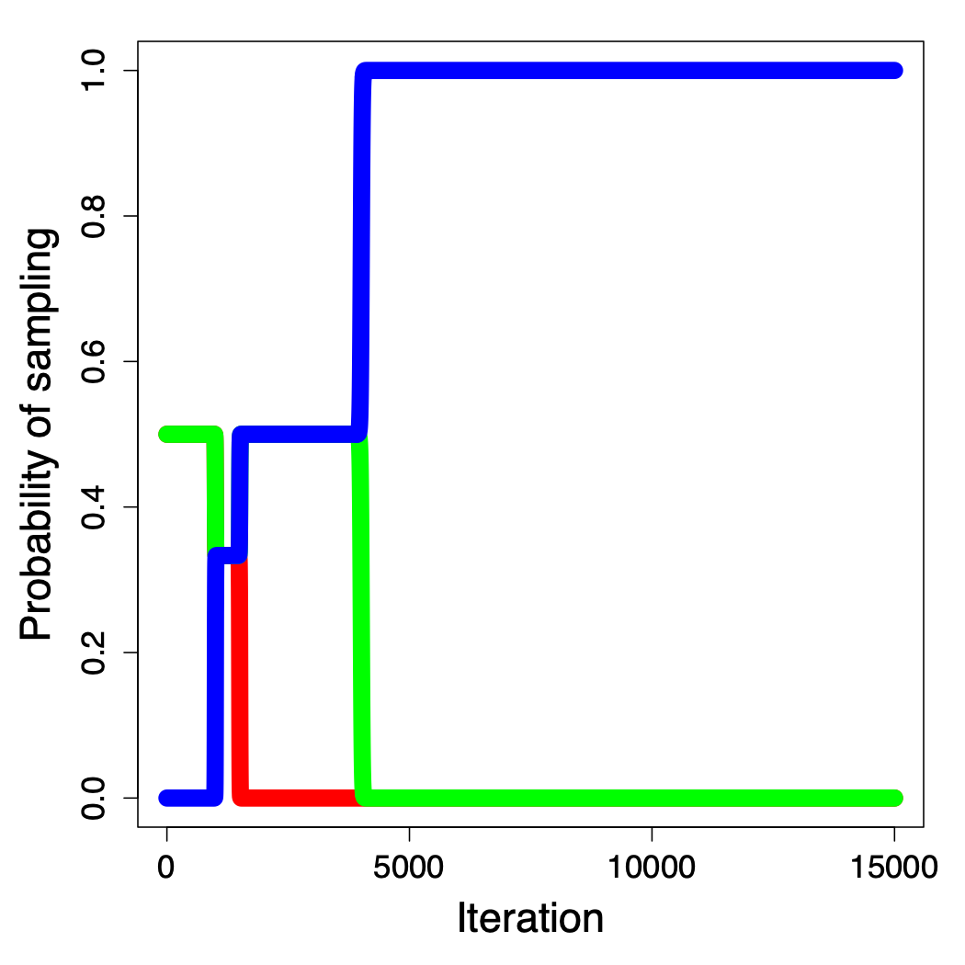
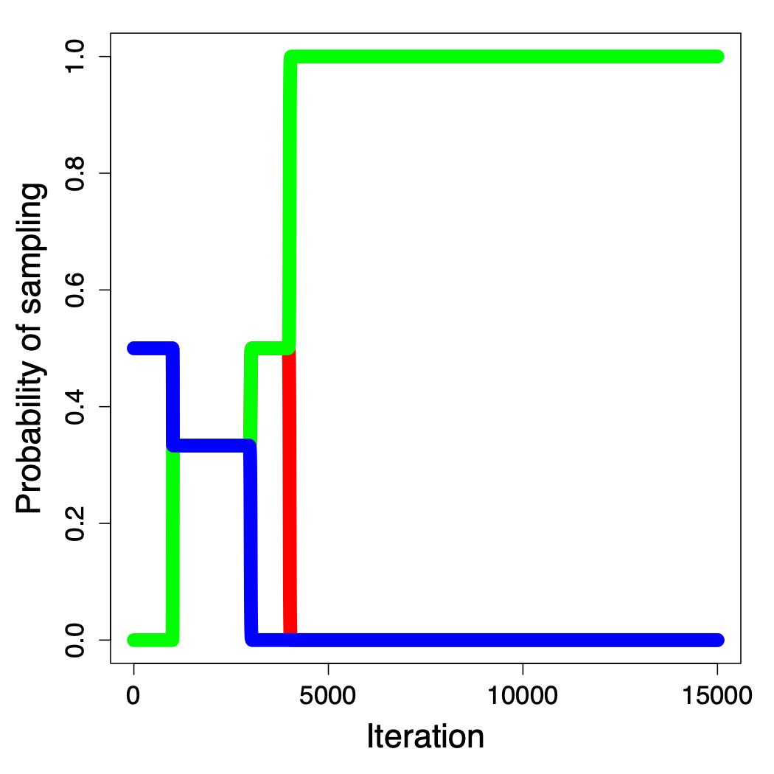
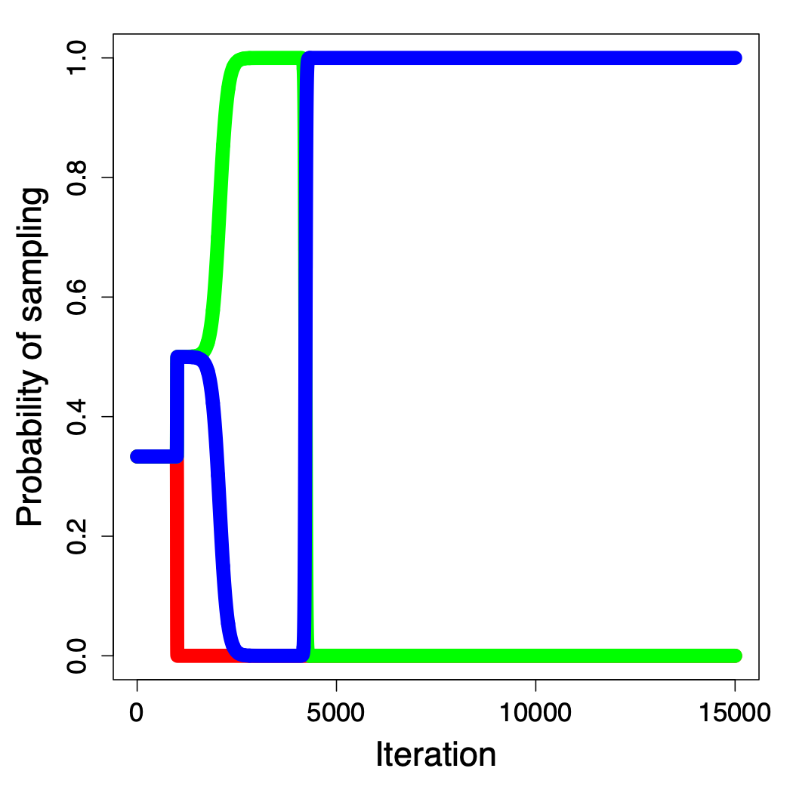
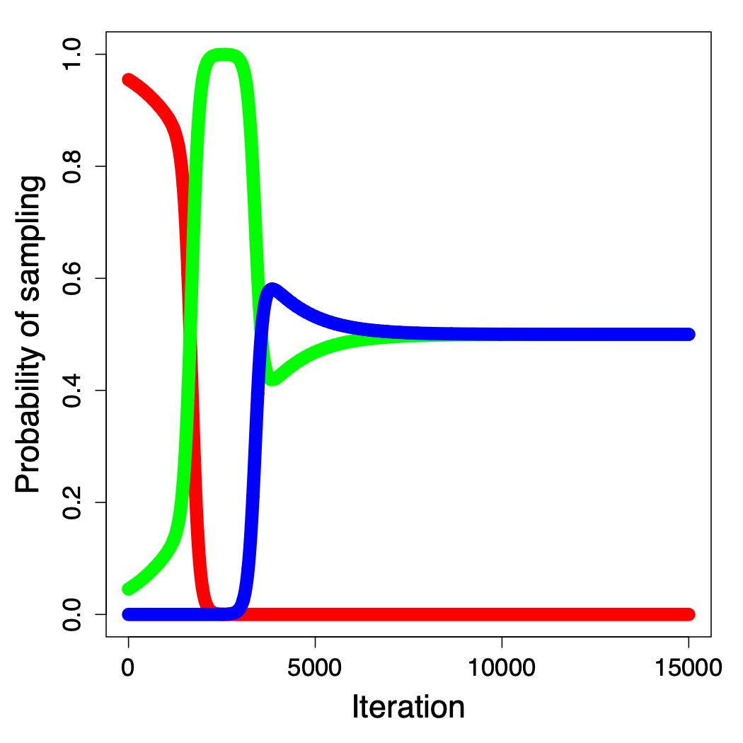
Synthetic Scenarios and Arrival Strategies
TRAIN

Slide 44
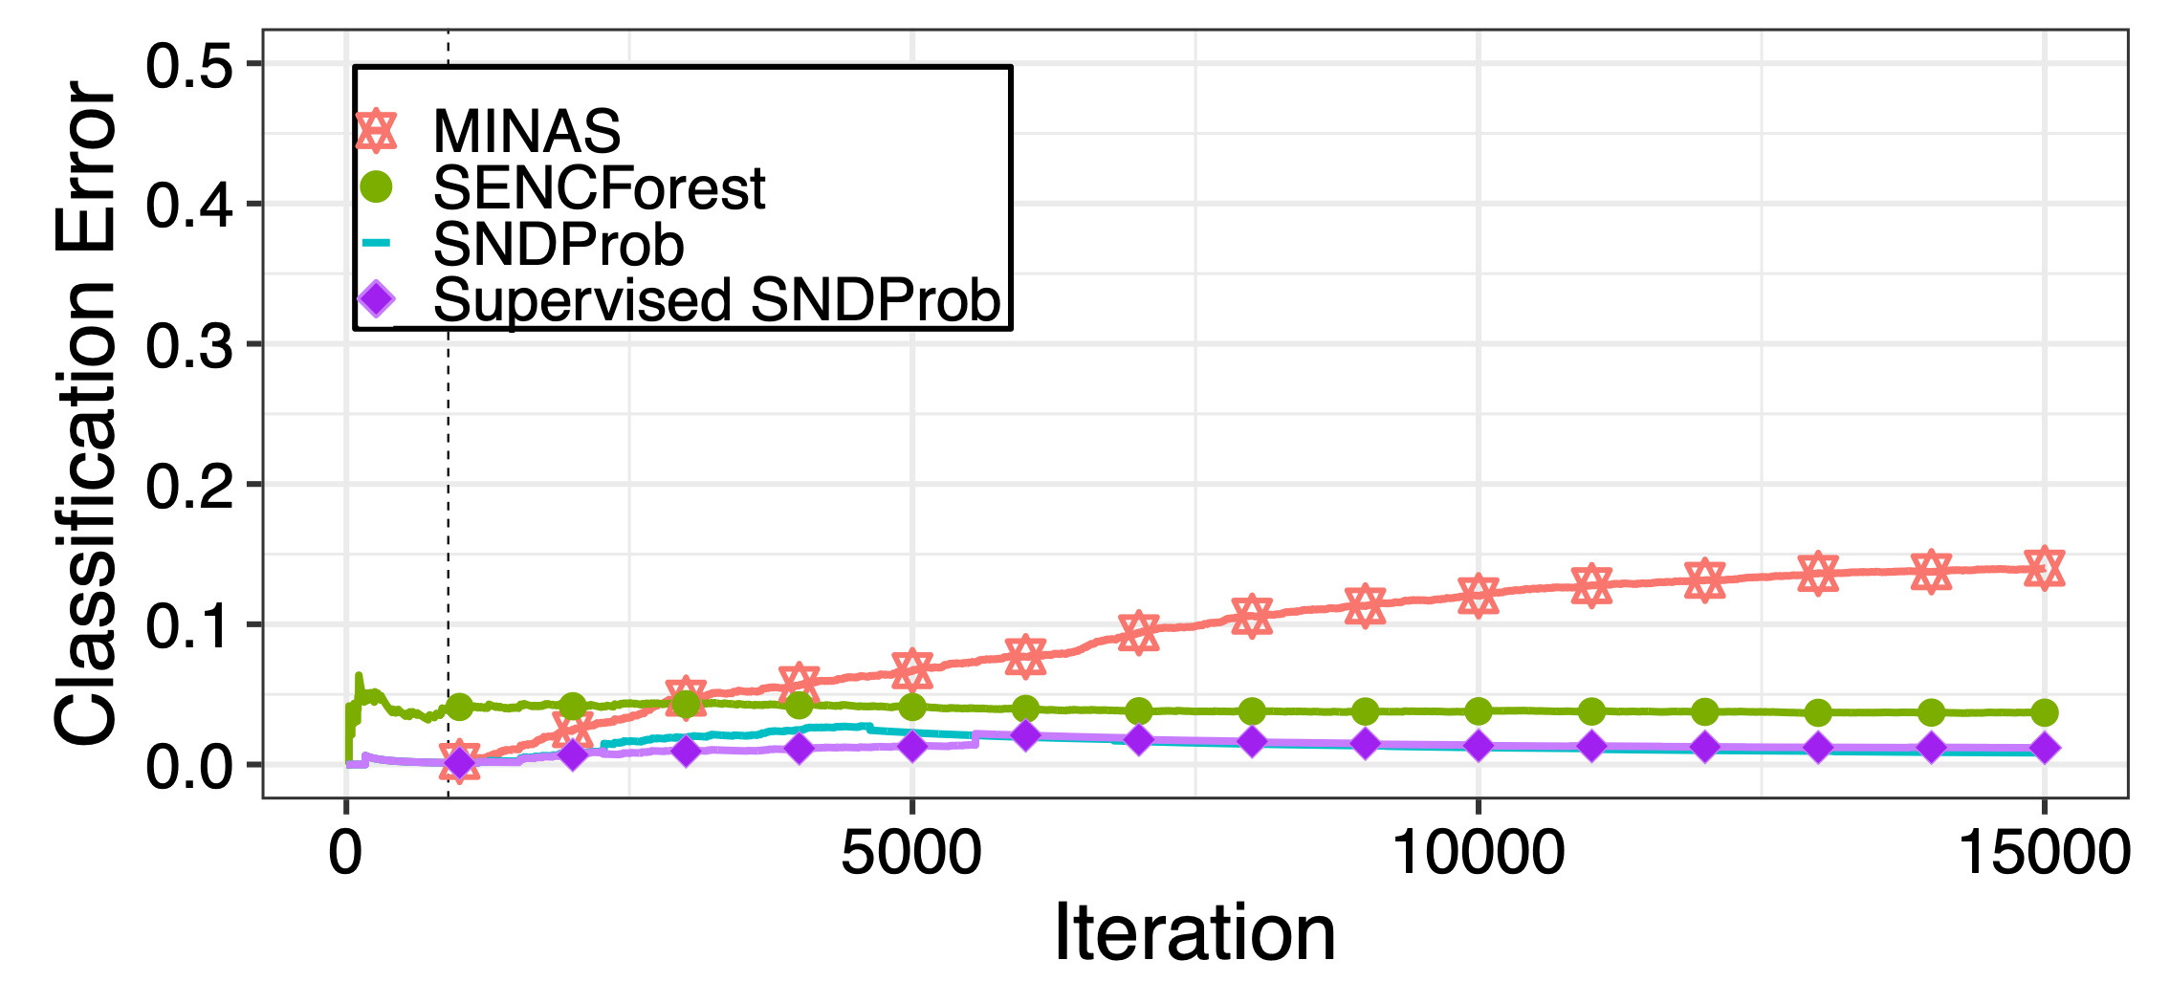
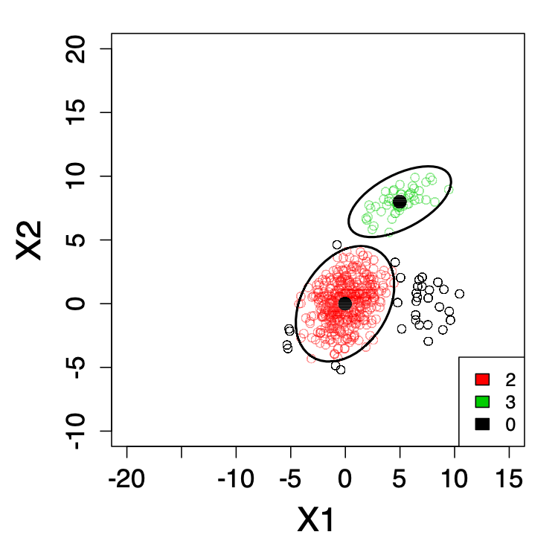

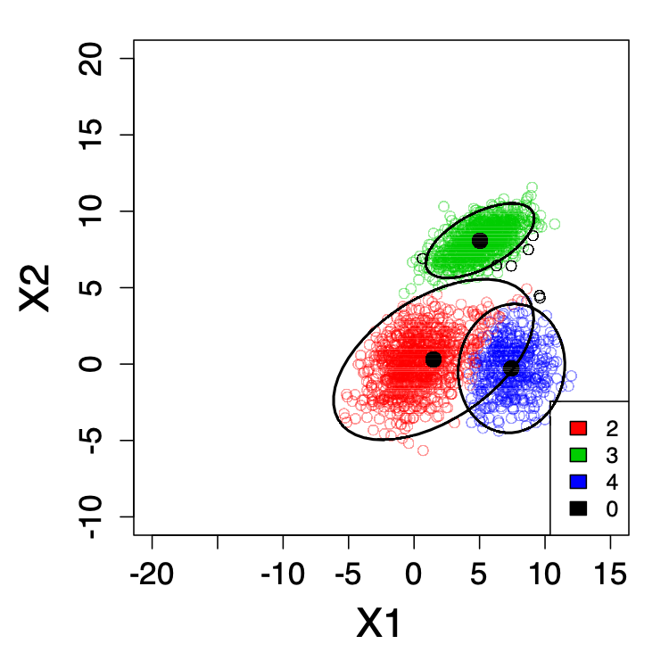
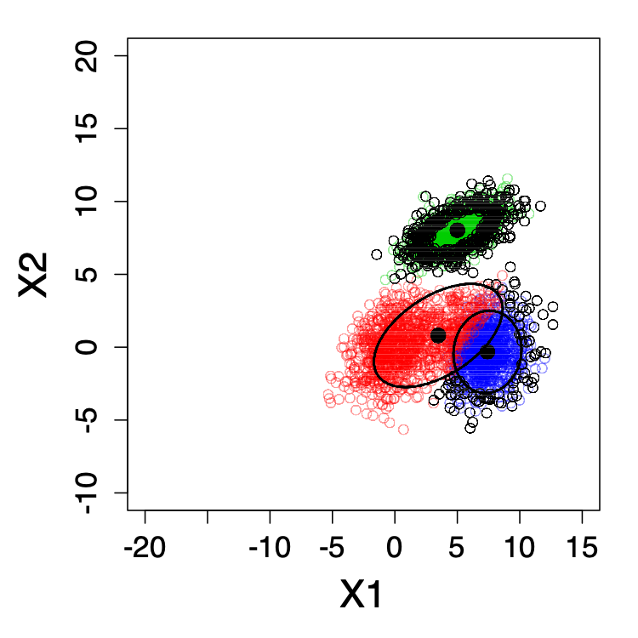
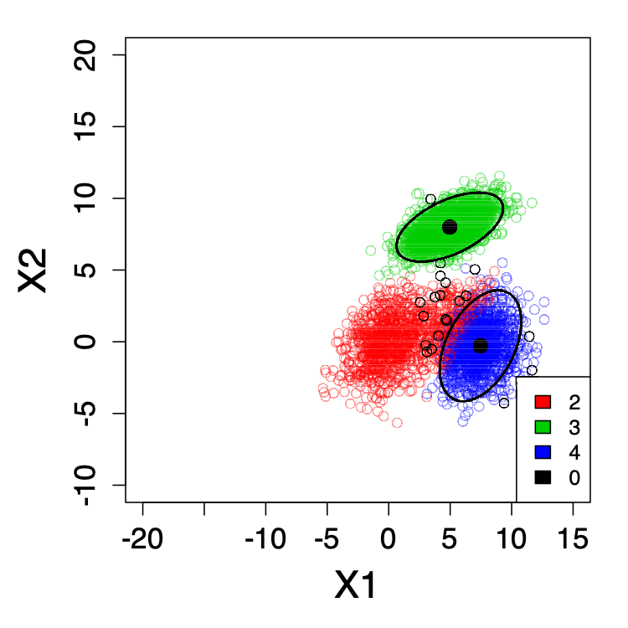
Scenario 1 - Arrival Strategy 1
Iteration 500
Iteration 2276
The buffer is full
Iteration 2500
Iteration 4676
The buffer is full
Iteration 5000
Red Class removed

Slide 45
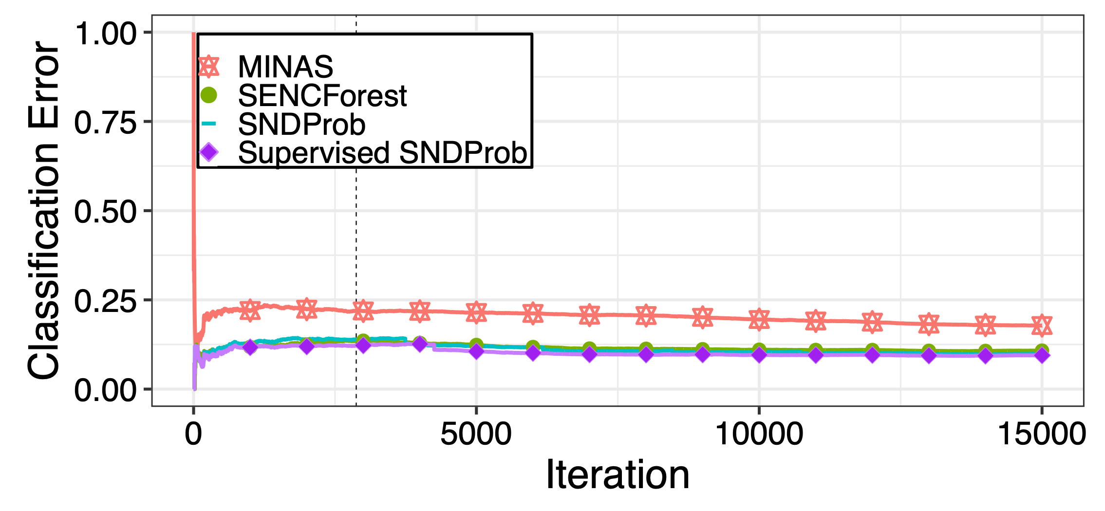
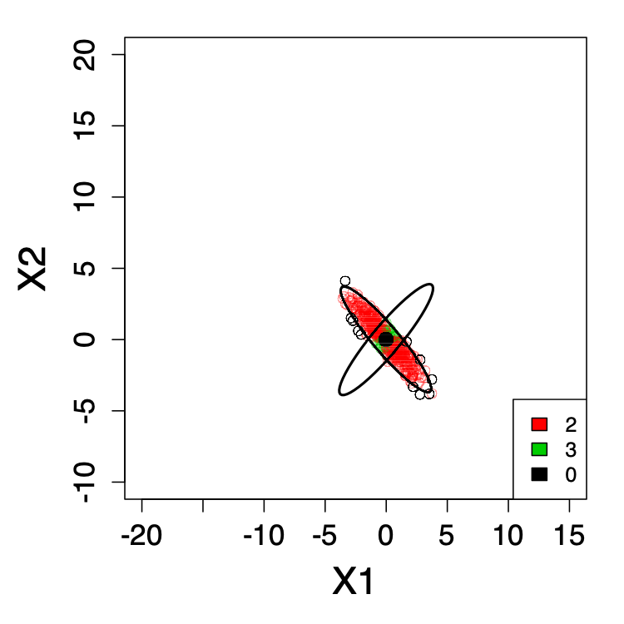
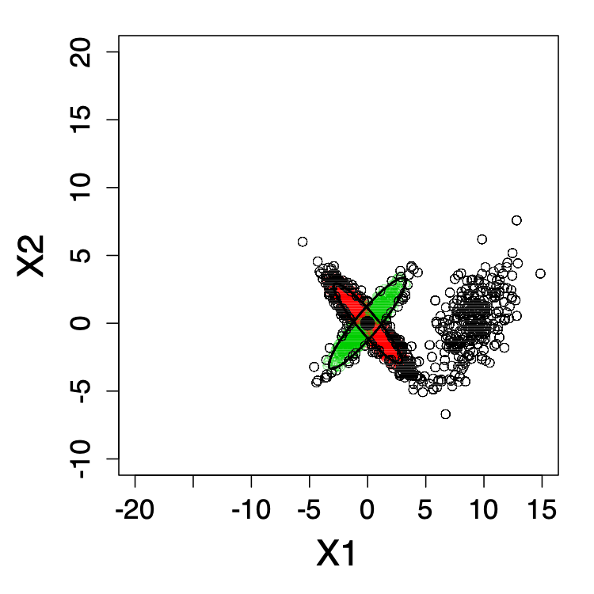



Scenario 4 - Arrival Strategy 2
Iteration 500
Iteration 3743
The buffer is full
Iteration 4000
Iteration 13013
The buffer is full
Iteration 13500
Notes:
Preparar bien el SNDProb
Superv SNDPRob it offers an illustrative upper bound for our SNDProb

Slide 46

Scenario 4 - Arrival Strategy 2
Notes:
Preparar bien el SNDProb
Superv SNDPRob it offers an illustrative upper bound for our SNDProb

Slide 47


Scenario 6 - Arrival Strategy 2

Slide 48

Scenario 1 - Arrival Strategy 1

Slide 49





Scenario 6 - Arrival Strategy 2
Iteration 500
Iteration 5122
The buffer is full
Iteration 5500
Iteration 11590
Iteration 13000

Slide 50
Conclusions
A robust probability based framework is developed and illustrated with a Mixture of Gaussians distribution
When data fulfills the assumptions of the selected probability distribution
Less buffer fills
Better concept learning. More robust
Thorough evaluation for the SND problem that serves as a guideline for future research
72 synthetic scenarios to serve as future baseline
Claim for a common evaluation methodology
Notes:
Parar y decir ahora las conclusions

Slide 51

Time Series Streaming Novelty Detection With Emerging New Classes
Notes:
Beber agua

Slide 52

General Flowchart of SND
Notes:
Esto mismo, pero ahora son series temporales

Slide 53

General Flowchart of SND

Slide 54
A solution based on Deep Learning
Autoencoders with Convolutional Layers
Provides a Deep Representation of the input time series
Deep Support Vector Data Description Networks (Deep SVDD) [Ruff, L., et. al. (2018)]
Similar to One Class Support Vector Machines
Ruff, L., et. al. (2018). Deep One-Class Classification. Proceedings of the 35th International Conference on Machine Learning (Vol. 80, pp. 4393–4402).
Notes:
Por que? Hemos mirado en la literatura y no hay mucho para modelar ts con prob.

Slide 55

How it works?
Autoencoder structure
Notes:
Autoencoder structure. No algorithm

Slide 56

How it works?
OFFLINE PHASE
Deep SVDD
In words…, it compresses the embeddings into a minimum volume hypersphere
Radius
Given Center
Penalizing factor
Anomaly Score
Distance to the center
of the hypersphere

Slide 57

Learning from data
OFFLINE PHASE
For each class, learn both Autoencoder and Deep SVDD networks
Autoencoder
Symmetric network with convolutional layers and MSE loss.
Deep Support Vector Data Description (Deep SVDD) network
Naturally provides an anomaly score

Slide 58


Prediction in a stream
ONLINE PHASE
Prediction — c = 1
Issue!
The proposed Deep SVDD was not proposed for streaming learning.
Offers a tight boundary to classify instances.
Concept Drift potentially affects the boundary making it unreliable for prediction
Introduce probability due to its interpretability as in SNDProb
Notes:
Sigma 1 sigma 2 cambiarlos de orden. X<>Y

Slide 59

Prediction in a stream
ONLINE PHASE

Slide 60
Prediction
ONLINE PHASE
How to classify a newcomer instance
Trick!
Mahalanobis Distance
The instance must be inside the X percentage of density mass
98%
98% of prob mass
Sent to buffer the
instances that fall in here
Notes:
Mejorar la imagen de la Gaussiana – Decir el buffer size!

Slide 61

Is this usable in real world?
New classes are discovered without supervision
Foto de Peter Herrmann en Unsplash
Notes:
Preparar la motivación y decir. Pero esto sin ground truth no es valido?

Slide 62
Parallel Universe
Parallel hypotheses
At some point the model looks for a certain amount of new emerging classes
Why we select just one hypothesis?
Keep track of every option and let an expert evaluate in hindsight
This grows exponentially! Compare models and remove identical ones to mitigate the exponential growth

Slide 63

Parallel Universe
Parallel hypotheses

Slide 64
Parallel Universe
How to cluster the data to learn a model?
We use an Agglomerative Hierarchical clustering algorithm
Dynamic Time Warping distance is used to measure the pairwise similarity between the time series

Slide 65
Parallel Universe
How to remove identical models?
Randomly generate multiple fixed length time series
Sample numbers from U(0,1)
Give these to two pertained autoencoders and see if the difference in reconstruction error is close
If this difference is below a threshold. Eliminate the newest model

Slide 66

EXPERIMENTAL STUDY
Photo by Julia Koblitz on Unsplash

Slide 67
Notes before the results
MINAS algorithm
When instances are introduced into the buffer, they are not counted as an Error or success!
SENCForest algorithm
It only can discover one class. It assigns the same class label (label 999) to all new instances
SNDProb
We provide predicted labels when the buffer is released for the buffered instances
Notes:
Preparar. As in the previous contribution, we encounter the same difficulties to unify the experimentation setup

Slide 68

Notes before the results
Datasets

Slide 69

Notes before the results
CBF dataset
BME dataset
Fifty Words dataset

Slide 70

Experimental results – CBF dataset

Slide 71

Experimental results – BME dataset

Slide 72

Experimental results – Fifty Words dataset

Slide 73
Conclusions
A novel SND method that deals with time series data for the first time is proposed
Interpretation insights are given when checking the accuracy curves of the experiments
A novel parallel universe framework that accounts for the current limitation of SND in real world applications

Slide 74

General Conclusions, Future Work &
Main achievements
Foto de Artur Aldyrkhanov en Unsplash

Slide 75
General Conclusions
A taxonomy of terms and learning scenarios is proposed after discovering a major issue in the literature
A SND problem was thoroughly researched where
We propose the first probabilistic solution in the field and open a new perspective in this área
We summarize the different evaluation scores proposed in the literature
We point out the need for a common evaluation methodology
We propose multiple synthetic scenarios for SND
For the first time, time series are considered in SND
We propose a solution to use SND approaches in real world situations (parallel universe)

Slide 76
Future Work
Extensions of proposed SND methods
SNDProb uses a mixture of Gaussian distributions as main actors
Propose other probabilistic families
Model each class with a mixture
Learn the buffer size from the stream

Slide 77
Future Work
Novel research lines in SND
Propose novel evaluation measures that consider the reactivity of the model
Following the probabilistic nature of SNDProb, propose a model for time series in SND based on Mixtures of Hidden Markov Model
Evolving features, new features emerge in the stream and others disappear

Slide 78
Main achievements
Journal publications
Carreño A., Inza, I., Lozano, J.A. (2020). Analyzing rare event, anomaly, novelty and outlier detection terms under the supervised classification framework. Artificial Intelligence Review, 53, 3575- 3594. Impact Factor: 8.139. Ranking: Q1 (14/139). Cites: 44.
Carreño A., Inza, I., Lozano, J. A. (2022). SNDProb: A Probabilistic Approach for Streaming Novelty Detection. IEEE Transactions on Knowledge and Data Engineering. In press. Impact Factor: 9,235. Ranking: D1 (10/164).

Slide 79
Main achievements
Conference publications
Carreño, A., Read, J., Inza, I., Lozano, J. A. (2022). Deep Time Series Streaming Novelty Detection with Emerging New Classes. Submitted to Association for the Advancement of Artificial Intelligence (AAAI) 2023. Ranking: A++.
As a result of the 3 month research stay at the École Polytechnique with Prof. Jesse Read.
Carreño, A., Inza, I., Lozano, J. A. (2018). Eventos raros, anomalías y novedades vistas desde el paraguas de la clasificación supervisada. XVIII Conferencia de la Asociación Española para la Inteligencia Artificial 925-930. Granada, Spain.
Workshop publications
Carreño A., Inza, I., Lozano, J. A. (2018). Discover Emerging New Classes. Balance between Supervised and Non-supervised Classification paradigms. 3rd Bilbao Data Science Workshop. Bilbao, Spain.

Slide 80

Main achievements – Software
https://github.com/andercarreno/SNDProb: SNDProb: A Probabilistic Approach for Streaming Novelty Detection. Developed in R language.
https://andercarreno.shinyapps.io/SNDProb: Interactive web for running and visualizing SNDProb: A Probabilistic Approach for Streaming Novelty Detection. Implemented with R-Shiny Apps.
https://github.com/andercarreno/SND_TimeSeries_SVDD: Time Series Streaming Novelty Detection. Developed in Python.

Slide 81
Other ongoing works
Antonenko, E., Read, J. (2022). Multi-modal Ensembles of Regressor Chains for Multi-output Prediction. In: Bouadi, T., Fromont, E., Hüllermeier, E. (eds) Advances in Intelligent Data Analysis XX. IDA 2022. Lecture Notes in Computer Science, vol 13205. Springer, Cham. Best paper award.
Improve the current work.
Provide a probabilistic perspective
Ortigosa-Hernández, J., Carreño, A., Inza, I. & Lozano, Jose A. (2022). Assessing Imbalanced Classification Problems: A Study on the Performance Scores. Submitted to the special issue on imbalanced classification of the Machine Learning journal. Impact Factor: 5,414. Ranking: Q2 (40/144).
Major revision
Time Series SND with a mixture of Hidden Markov Models.

Slide 82
Advances in Streaming Novelty Detection
By Ander Carreño – Ph. D. Candidate
Supervised by: Iñaki Inza and Jose A. Lozano
Notes:
This is all on my side

